Slide 1
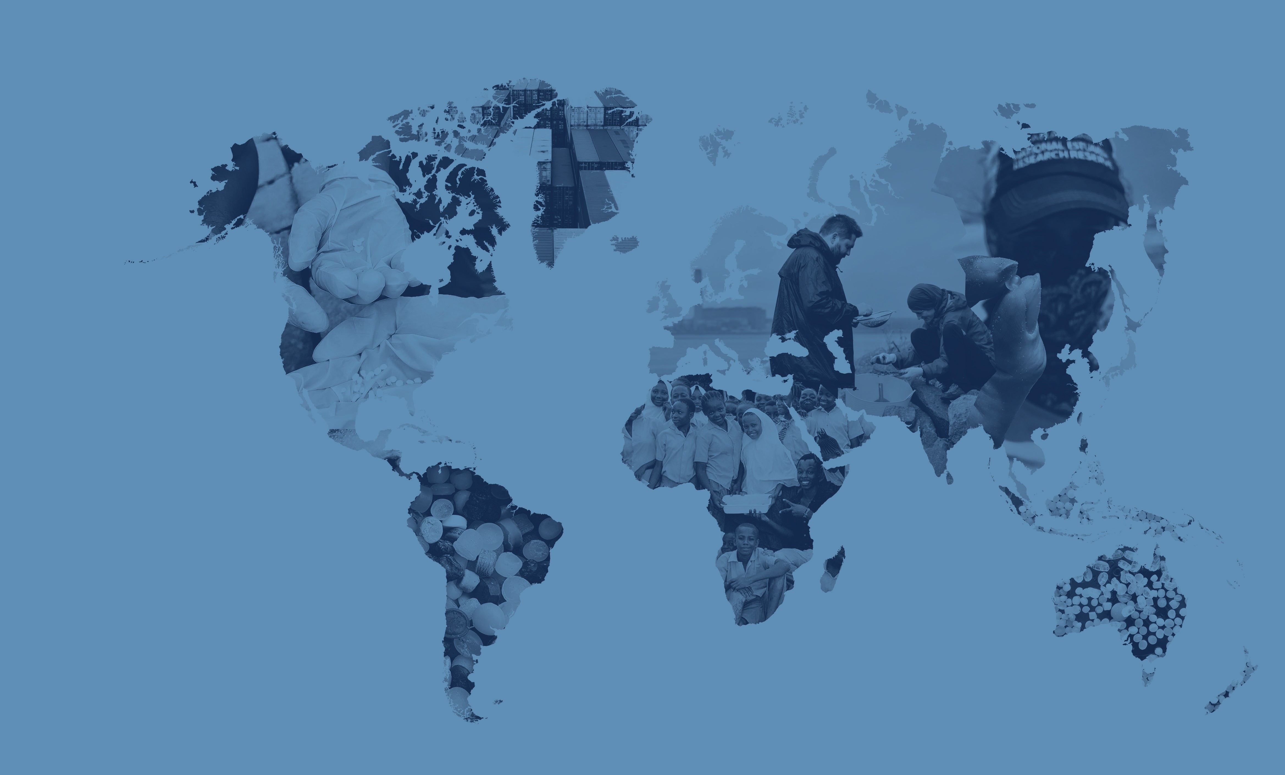
Mapping
The Global Plastic Pellet Supply Chain
Fidra is a Scottish registered charity and SCIO no.SC043895

Slide 2
Global Plastics Outlook
In 2021 world plastic production reached 390 million tonnes and this is predicted to grow to 1,200 million tonnes annually by 2060.
The plastics industry is truly global with 73% of countries importing primary plastics in 2021.
Most primary plastic is produced in the form of plastic pellets. It is estimated that up to 22.4 trillion pellets are released to the environment each year globally.

Slide 3
Fidra is a Scottish registered charity and SCIO no.SC043895

Slide 4
Africa and Middle East
Region accounted for 8% of global plastic production in 2021
33 countries involved in export trade of primary plastics and 42 involved in import trade
Up to 49,000 tonnes per year estimated pellet loss to the environment

Slide 5
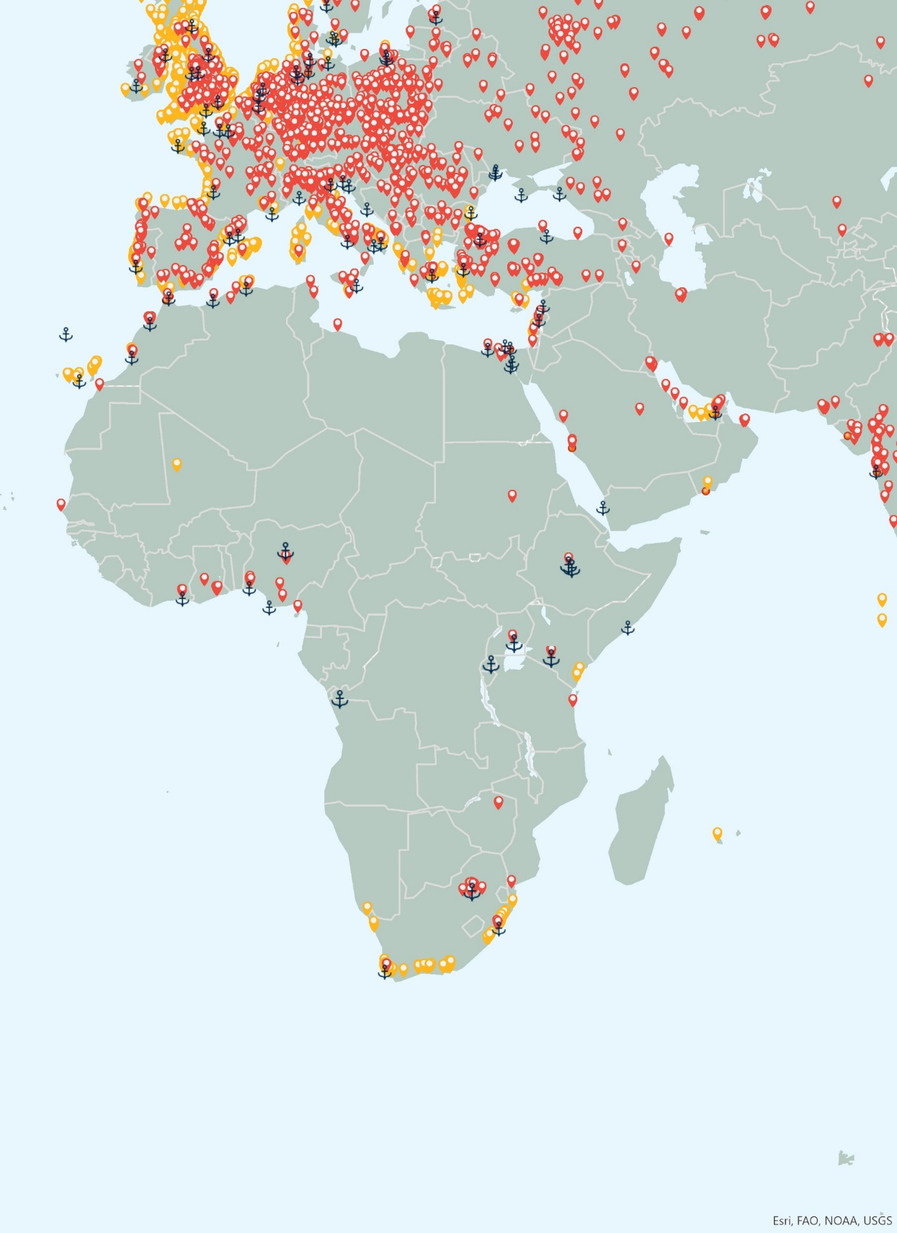
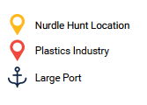
Key Findings
Mapping The Global Plastic Pellet Supply Chain
P3
The region accounted for 8% of global plastic production in 2021¹
Saudi Arabia was the world’s second largest exporter of primary plastics, by trade value, in 2021²
16% of global trade value in primary plastic exports in 2021²
7% of global trade value in primary plastic imports in 2021²
Over 112 plastics recycling plants ³ (4% of global share based on industry database)
Plastics industry, nurdle hunts and large ports
Citations:
1 Plastics Europe - https://plasticseurope.org/knowledge-hub/plastics-the-facts-2022, 2022.
2. World Bank. World Integrated Trade Solutions. https://wits.worldbank.org
3. ENF Recycling - World's Largest Directory Of Recycling Companies. [https://www.enfrecycling.com/

Slide 6
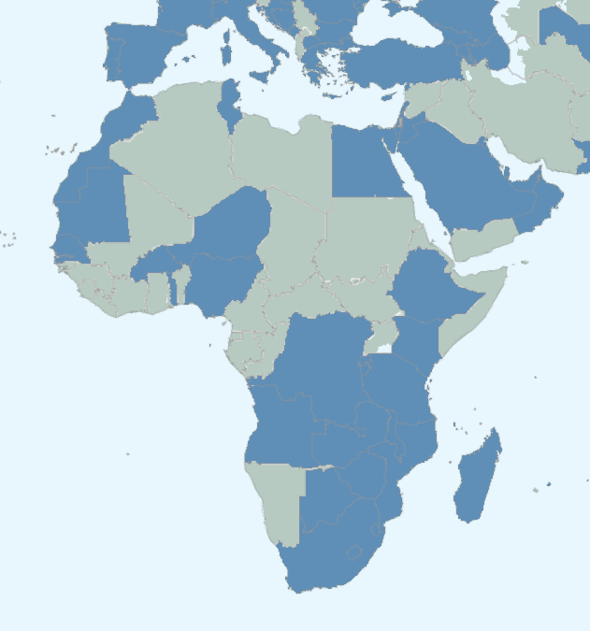
Key Findings
Mapping The Global Plastic Pellet Supply Chain
P3
Africa
Nigeria – largest importer of plastics in primary forms in Africa ²
Egypt – Largest exporter of plastic in primary forms in 2021 ²
South Africa – Largest number of plastic recycling plants in Africa ⁷
Importers and Exporters of primary plastics (highlighted blue)
Citations:
1 Plastics Europe - https://plasticseurope.org/knowledge-hub/plastics-the-facts-2022, 2022.
2. World Bank. World Integrated Trade Solutions. https://wits.worldbank.org
3. ENF Recycling - World's Largest Directory Of Recycling Companies. [https://www.enfrecycling.com/

Slide 7
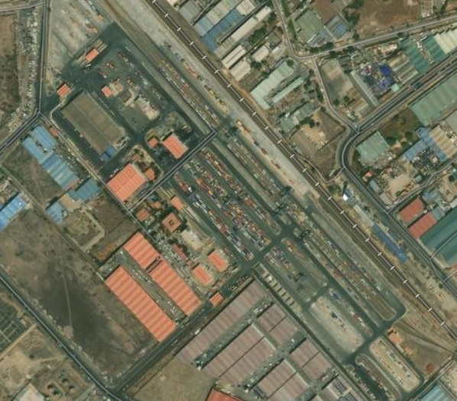
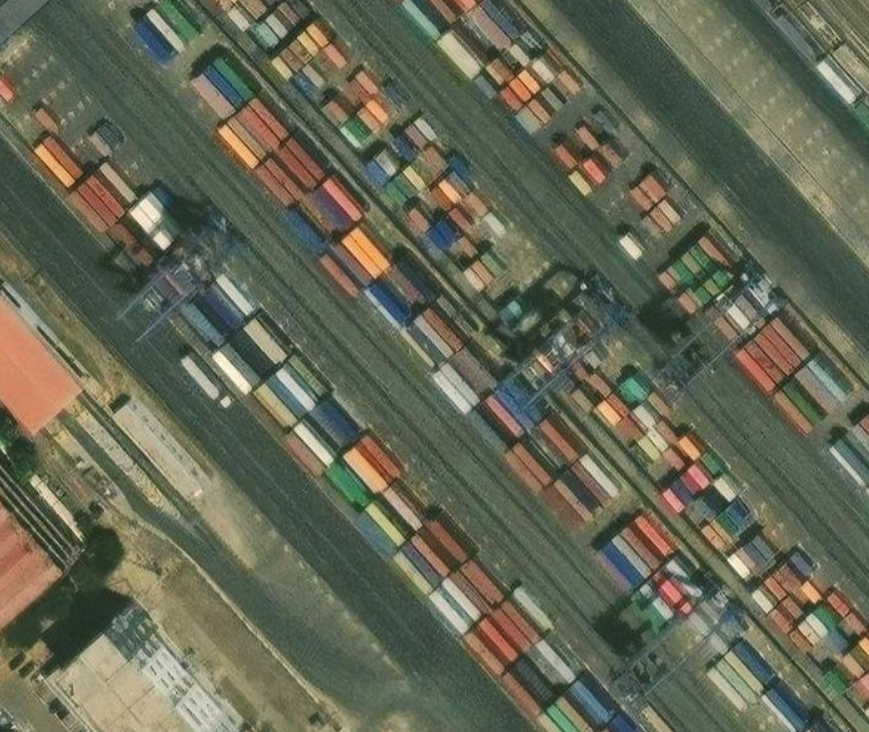
Transport
Mapping The Global Plastic Pellet Supply Chain
P3
The region has 6 of the world’s top 50 container ports by volume handled and 21 large ports¹ handling over 62 million TEU of container traffic in 2021²
Largest port in the region by container traffic in 2021 was Jebel Ali Port, Dubai
Africa has large inland dry ports and container depots
Inland Container Depot, Nairobi, Kenya
(Maxar | Esri Eastern Africa, Esri, HERE, Garmin, Foursquare, METI/NASA, USGS)
TEU- twenty-foot equivalent unit
Citations:
1. World Ports Index (https://msi.nga.mil/Publications/WPI)
2. World Bank, World Development Indicators, https://databank.worldbank.org/source/world-development-indicators

Slide 8
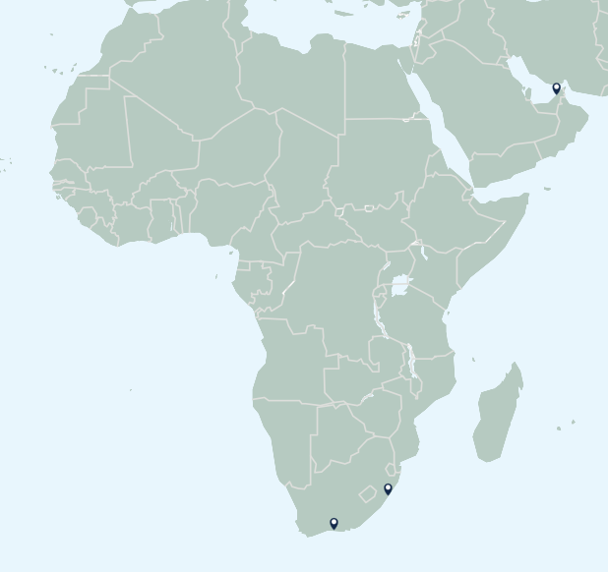
Pellet Loss
Mapping The Global Plastic Pellet Supply Chain
P3
Estimated that 4,900 - 49,000 tonnes of pellets lost to the environment annually
3 acute pellet losses identified
All identified losses were related to losses from container shipping
2 incidents off coast of South Africa - 223.5 tonnes of pellets lost in total
Acute & Chronic pellet loss incidents
Citations:
1. Fidra. The Great Nurdle Hunt, https://www.nurdlehunt.org.uk,
2. Nurdle Patrol, https://nurdlepatrol.org.map

Slide 9
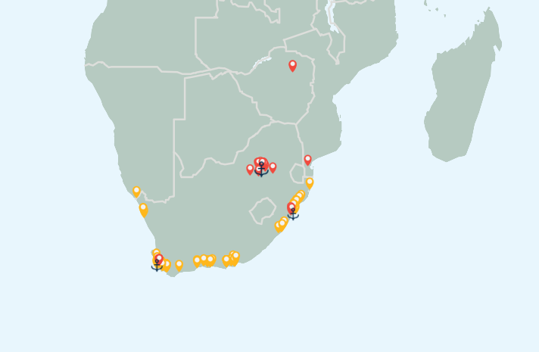
Tourism & Protected Areas
Mapping The Global Plastic Pellet Supply Chain
P3
Over 4.3 million km² of terrestrial protected areas and over 2.4 million km² of marine protected areas in Africa¹
South Africa has over 239,000 km² of marine and coastal protected areas^{1 –} almost 10% of the continents total
Largest concentration of positive nurdle hunts found along coast of South Africa
South Africa had 10.2 million tourist arrivals in 2019 ²
South Africa –Tourism accounted for 4.7% of employment in 2019³
Plastics industry, nurdles and large ports in South Africa
Citations:
1. Protected Planet, https://www.protectedplanet.net/en
2. UN WTO – Global and regional tourism performance (https://www.unwto.org/tourism-data/global-and-regional-tourism-performance)
3. OECD Tourism trends and policies, 2022 (https://www.oecd-ilibrary.org/docserver/a8dd3019-en.pdf?expires=1685541669&id=id&accname=guest&checksum=24EDEA830CD56010BF19DE2E62EBF6AD

Slide 10
Fishing
Mapping The Global Plastic Pellet Supply Chain
Africa landed over 7 million tonnes of fish from marine fisheries in 2017²
Fishing sector expected to support 20.7 million jobs by 2030 under a ‘business as usual’ scenario²
Local industry and livelihoods already under threat from domestic and foreign commercial fishing activities³
Losses of pellets likely to put further pressure on industry and affect livelihoods
Citations:
1. Protected Planet, https://www.protectedplanet.net/en
2. Chan CY, Tran N, Cheong KC, Sulser TB, Cohen PJ, Wiebe K, et al. (2021) The future of fish in Africa: Employment and investment opportunities. PLoS ONE 16(12): e0261615. https://doi.org/10.1371/journal.pone.02616153.
3. https://wwf.panda.org/discover/knowledge_hub/where_we_work/west_africa_marine/area/fisheries/

Slide 11
Mapping The Global Plastic Pellet Supply Chain
More information and assets can be found at:
https://hub.nurdlehunt.org/resource/oracle-mapping-the-global-plastic-pellet-supply-chain/

