Slide 1
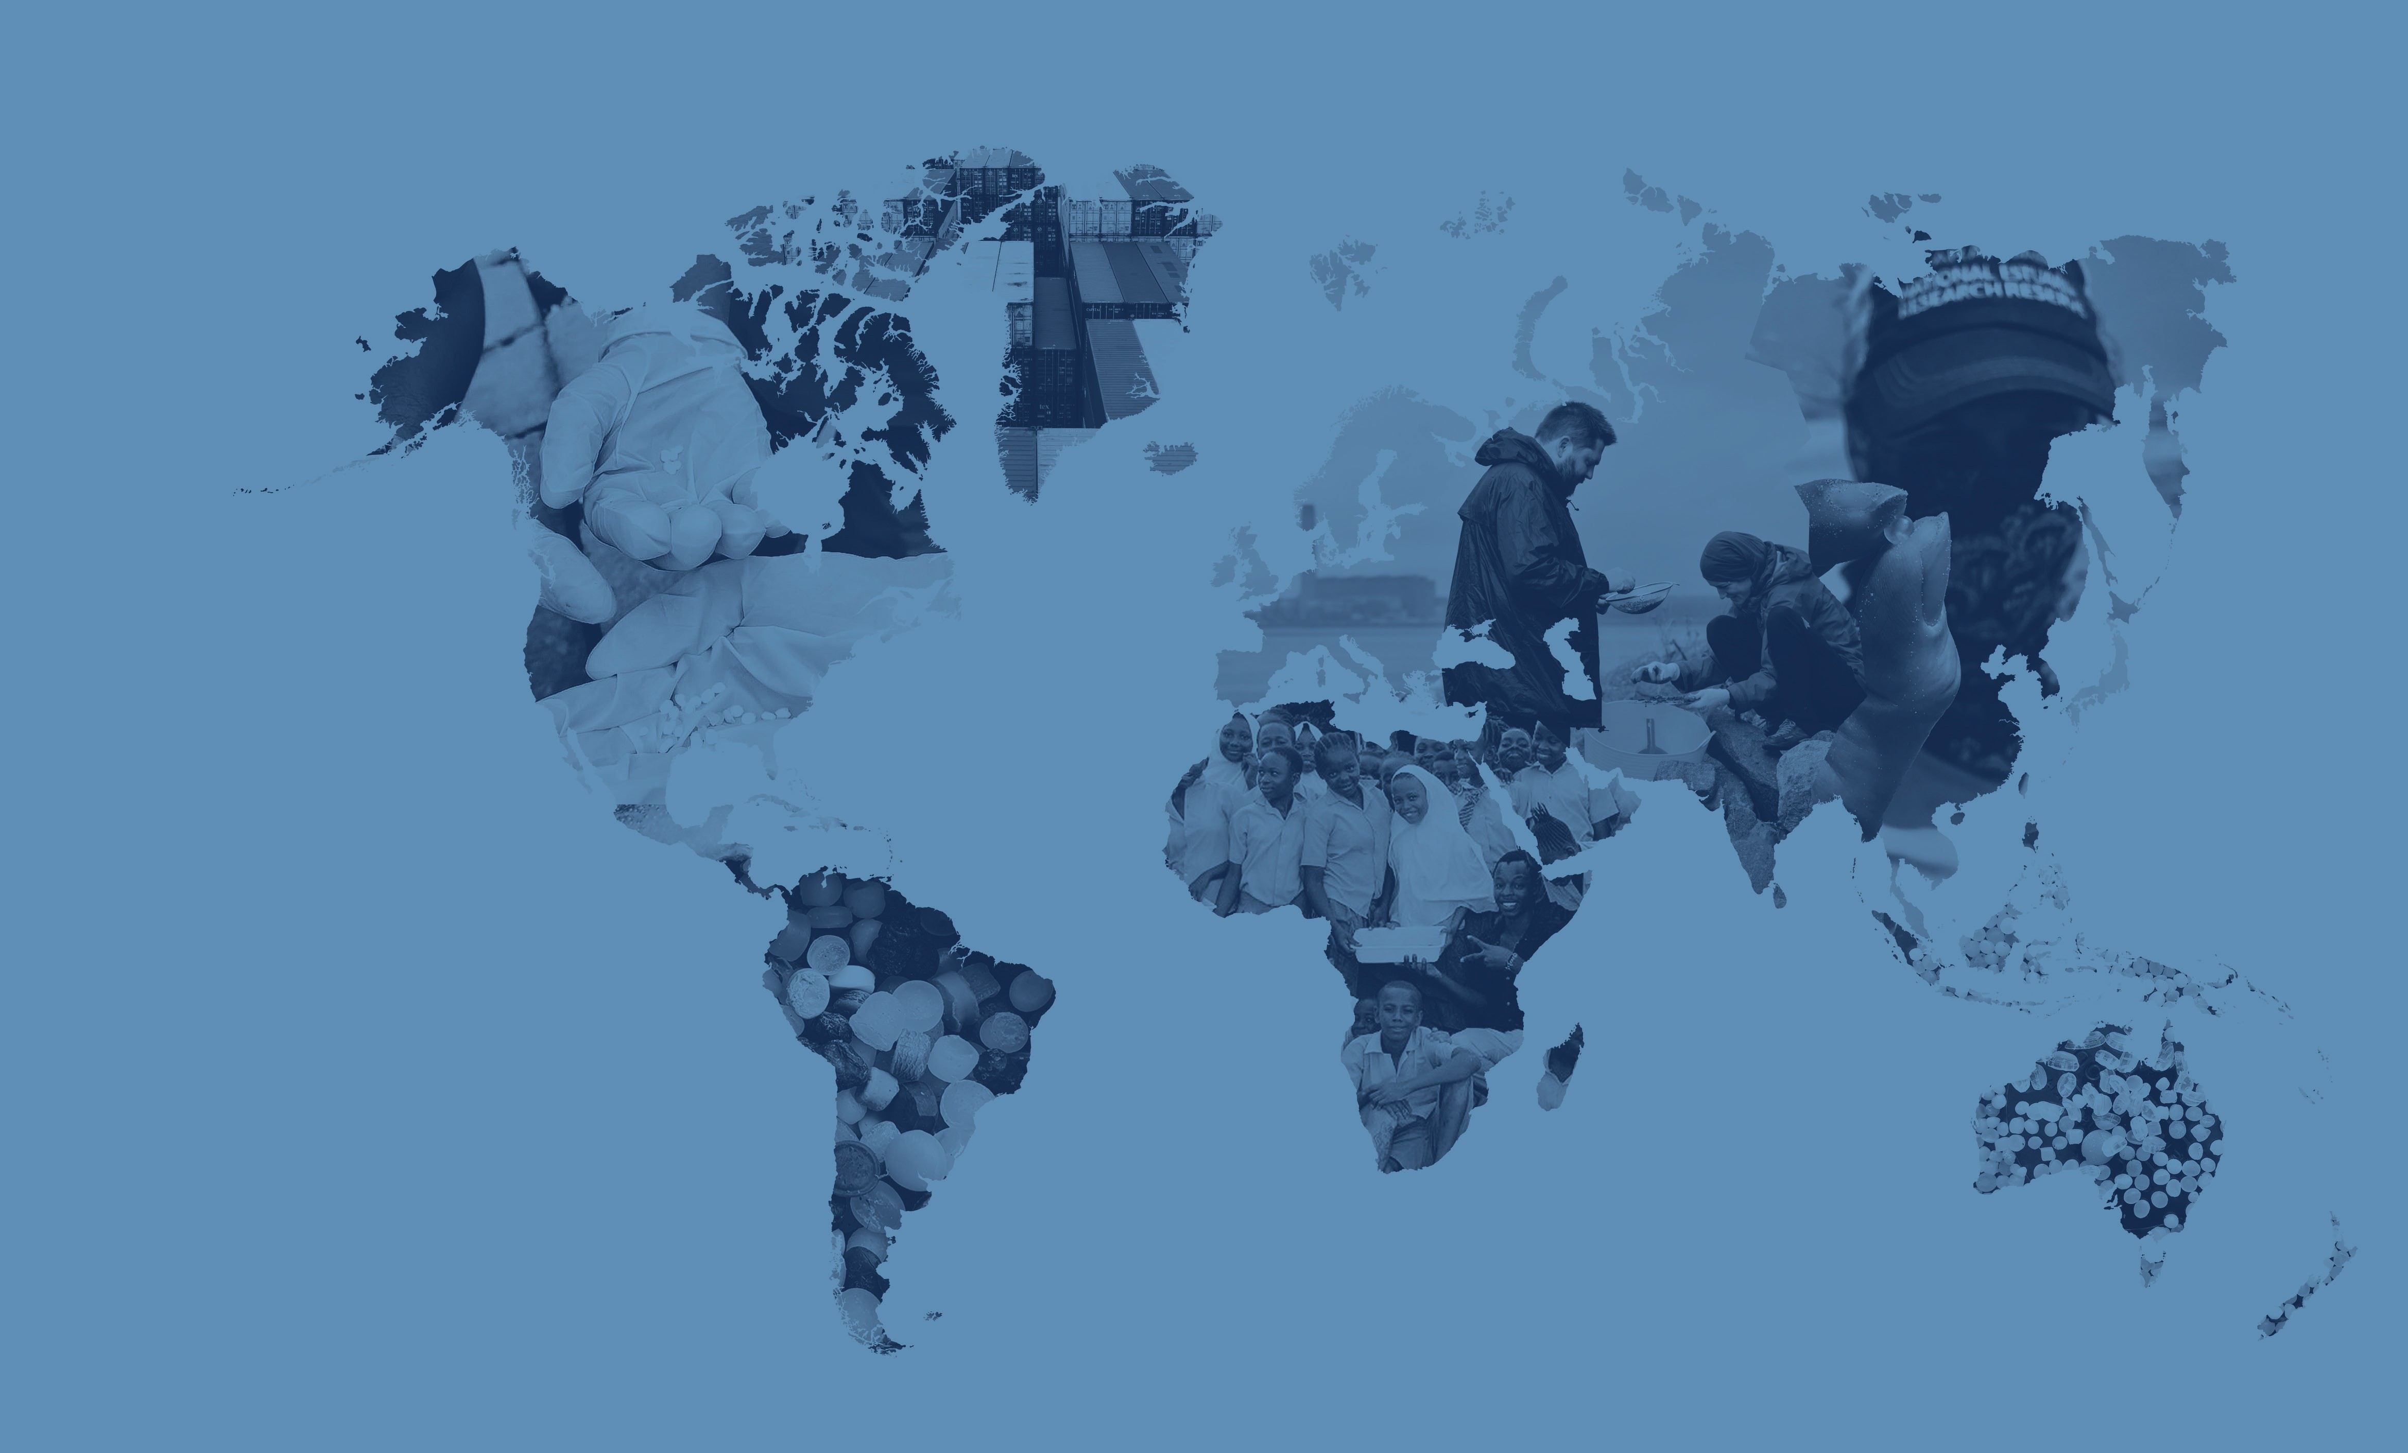
Mapping
The Global Plastic Pellet Supply Chain
Fidra is a Scottish registered charity and SCIO no.SC043895

Slide 2
Global Plastics Outlook
In 2021 world plastic production reached 390 million tonnes and this is predicted to grow to 1,200 million tonnes annually by 2060.
The plastics industry is truly global with 73% of countries importing primary plastics in 2021.
Most primary plastic is produced in the form of plastic pellets. It is estimated that up to 22.4 trillion pellets are released to the environment each year globally.

Slide 3
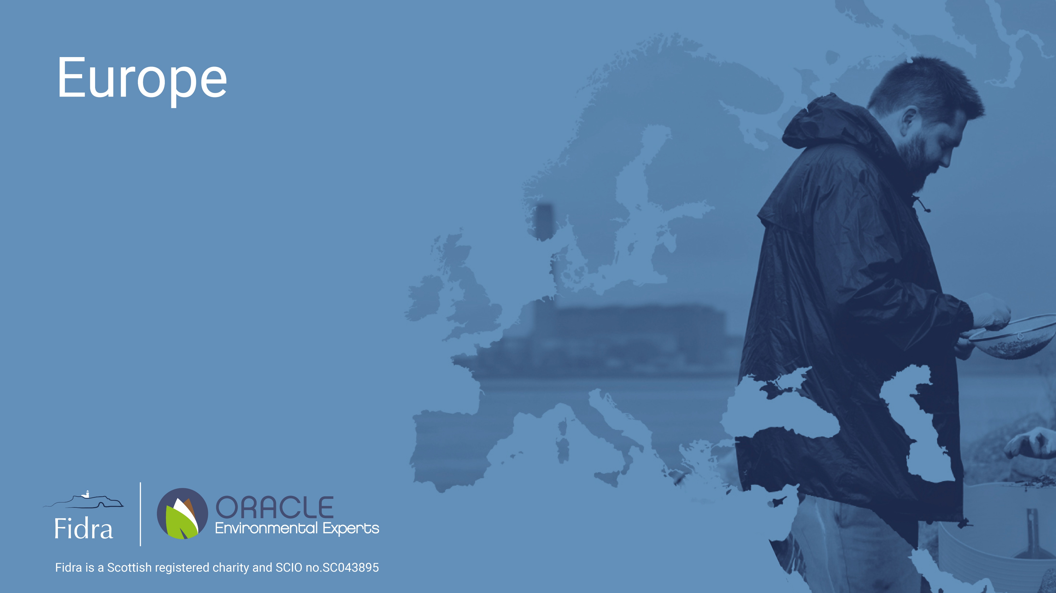
Europe
Fidra is a Scottish registered charity and SCIO no.SC043895

Slide 4
Europe
A well-established plastics industry is present in Europe, and it has been identified as having the largest regional share of primary plastic import and export trade
Based on this it is projected to be the region with the largest potential pellet loss
Europe is the region with the highest number of plastic recycling plants

Slide 5
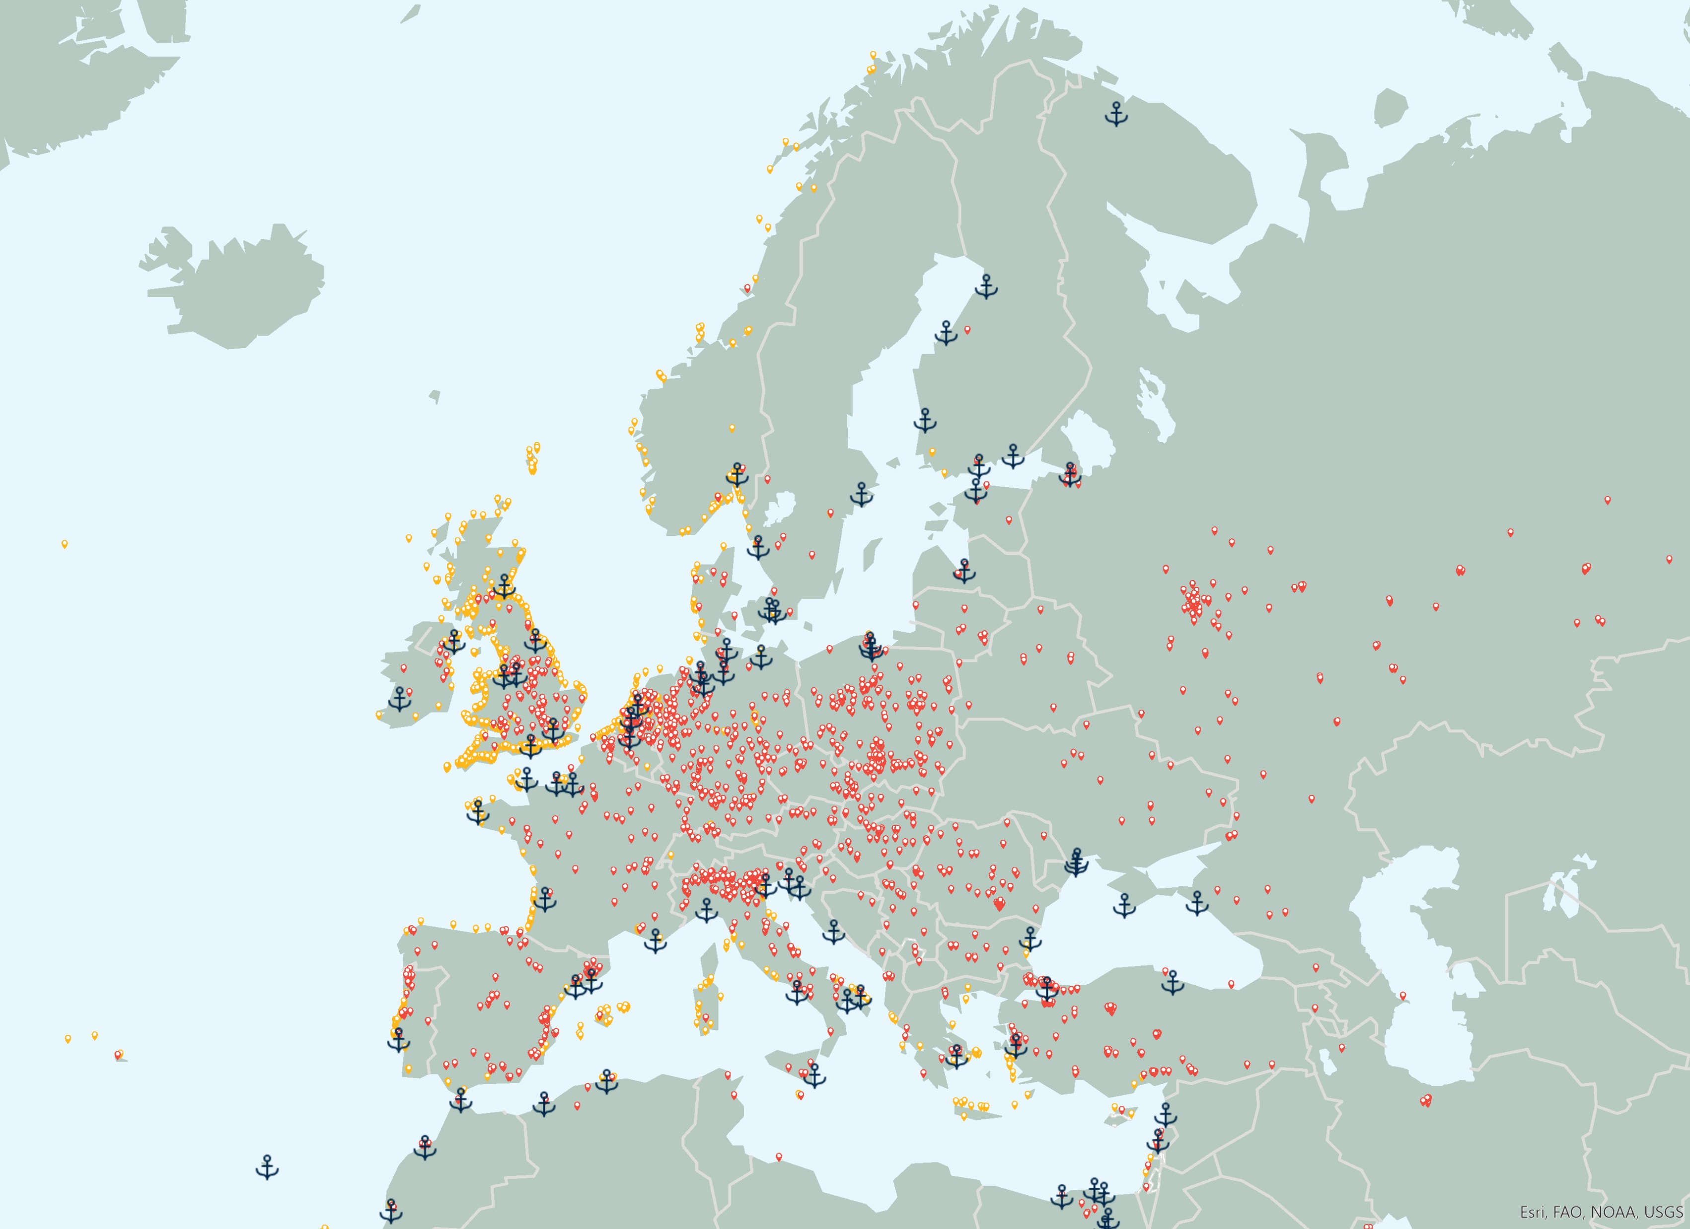
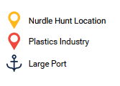
Key Findings
Mapping The Global Plastic Pellet Supply Chain
European Union – 15% of world plastic production in 2021¹
European Union - More than 1.5 million people employed in plastics industry¹
Accounted for 40% of world trade imports of plastics in primary forms in 2021 ²
Accounted for 35% of world trade exports of plastics in primary forms in 2021 ²
4 of world’s top 10 exporters of plastics in primary forms²
5 of world’s top 10 importers of plastics in primary forms²
Plastics industry, nurdle hunts and large ports in Europe
Citations:
1 Plastics Europe - https://plasticseurope.org/knowledge-hub/plastics-the-facts-2022, 2022.
2. World Bank. World Integrated Trade Solutions. https://wits.worldbank.org
3. 2022 Size and Impact Report, Plastics Industry Association (https://www.plasticsindustry.org/sizeandimpact)
4. ENF Recycling - World's Largest Directory Of Recycling Companies. [https://www.enfrecycling.com/

Slide 6
Key Findings
Mapping The Global Plastic Pellet Supply Chain
European Union – Over 52,000 businesses involved in plastics industry¹
Over 1,400 plastics recycling plants ⁴ (54% of global share based on industry database)
Germany – World’s Second largest importer and 4th largest exporter of plastics in primary forms in 2021 by trade value²
Plastics industry, nurdle hunts and large ports in Europe
Citations:
1 Plastics Europe - https://plasticseurope.org/knowledge-hub/plastics-the-facts-2022, 2022.
2. World Bank. World Integrated Trade Solutions. https://wits.worldbank.org
3. 2022 Size and Impact Report, Plastics Industry Association (https://www.plasticsindustry.org/sizeandimpact)
4. ENF Recycling - World's Largest Directory Of Recycling Companies. [https://www.enfrecycling.com/

Slide 7
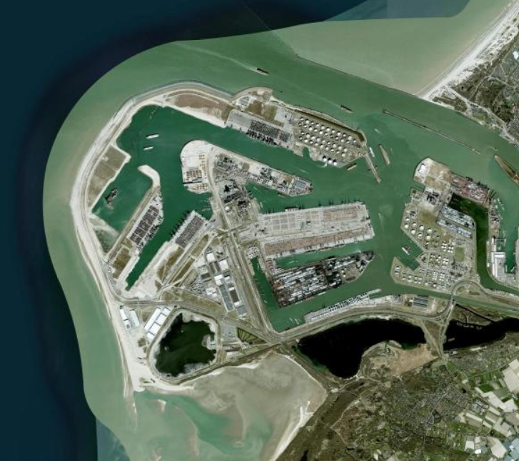
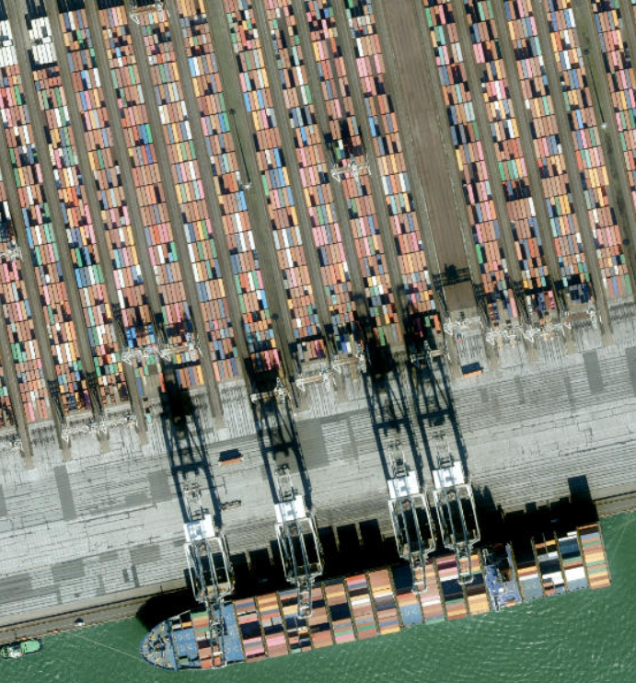
Transport
Mapping The Global Plastic Pellet Supply Chain
Europe has 7 of the world’s top 50 container ports by volume handled and 55 large ports¹ handling over 56 million TEU of container traffic in 2021²
European Union
In 2021, 67.9% of freight was maritime, 24.6% was by road and 5.4% was by rail³
Germany accounted for 23.8% of goods transported by road in 2021⁴
16 pellet loss incidents associated with transportation identified
Port of Rotterdam, Netherlands (Beeldmateriaal.nl, Earthstar Geographics, Maxar, Microsoft)
TEU- twenty-foot equivalent unit
Citations:
1. World Ports Index (https://msi.nga.mil/Publications/WPI)
2. World Bank, World Development Indicators, https://databank.worldbank.org/source/world-development-indicators
3. Eurostat- https://ec.europa.eu/eurostat/statistics-explained/index.php?title=Freight_transport_statistics_-_modal_split
4. Eurostat - https://ec.europa.eu/eurostat/statistics-explained/index.php?title=Road_freight_transport_statistics#In_2021.2C_Germany.2C_France.2C_Spain.2C_Poland_and_Italy_accounted_for_almost_two_thirds_of_the_total_tonnage_transported_in_the_EU

Slide 8
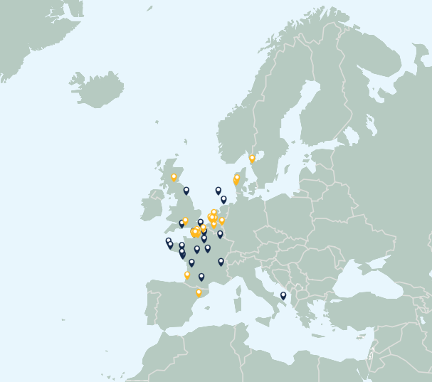
Pellet Loss
Mapping The Global Plastic Pellet Supply Chain
Estimated that 16,000-167,000 tonnes of pellets lost to the environment annually
24 acute and 26 chronic pellet losses identified
Over 10,000 tonnes of pellets identified as lost from 14 incidents
38 terrestrial and 12 marine incidents
31 incidents in France reported
Acute & Chronic pellet loss incidents
Citations:
1. Fidra. The Great Nurdle Hunt, https://www.nurdlehunt.org.uk,
2. Nurdle Patrol, https://nurdlepatrol.org.map

Slide 9
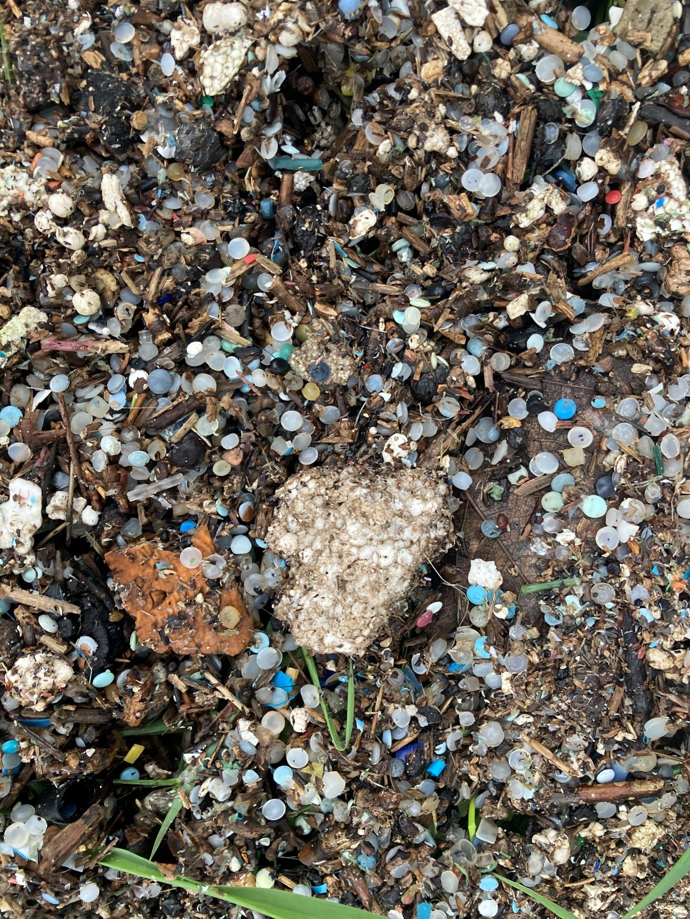
Protected Areas & Tourism
Mapping The Global Plastic Pellet Supply Chain
130,000 protected areas in Europe covering 23% of the continent
Pellet presence confirmed in protected areas.
Example – Chessel Bay, England – Site of Special Scientific Interest
France and Spain – 1st and 2nd most visited countries globally
Large number of pellet incidents report in France
Chessel Bay, England
Citations:
1. Protected Planet, https://www.protectedplanet.net/en
2. UN WTO – Global and regional tourism performance (https://www.unwto.org/tourism-data/global-and-regional-tourism-performance)

Slide 10
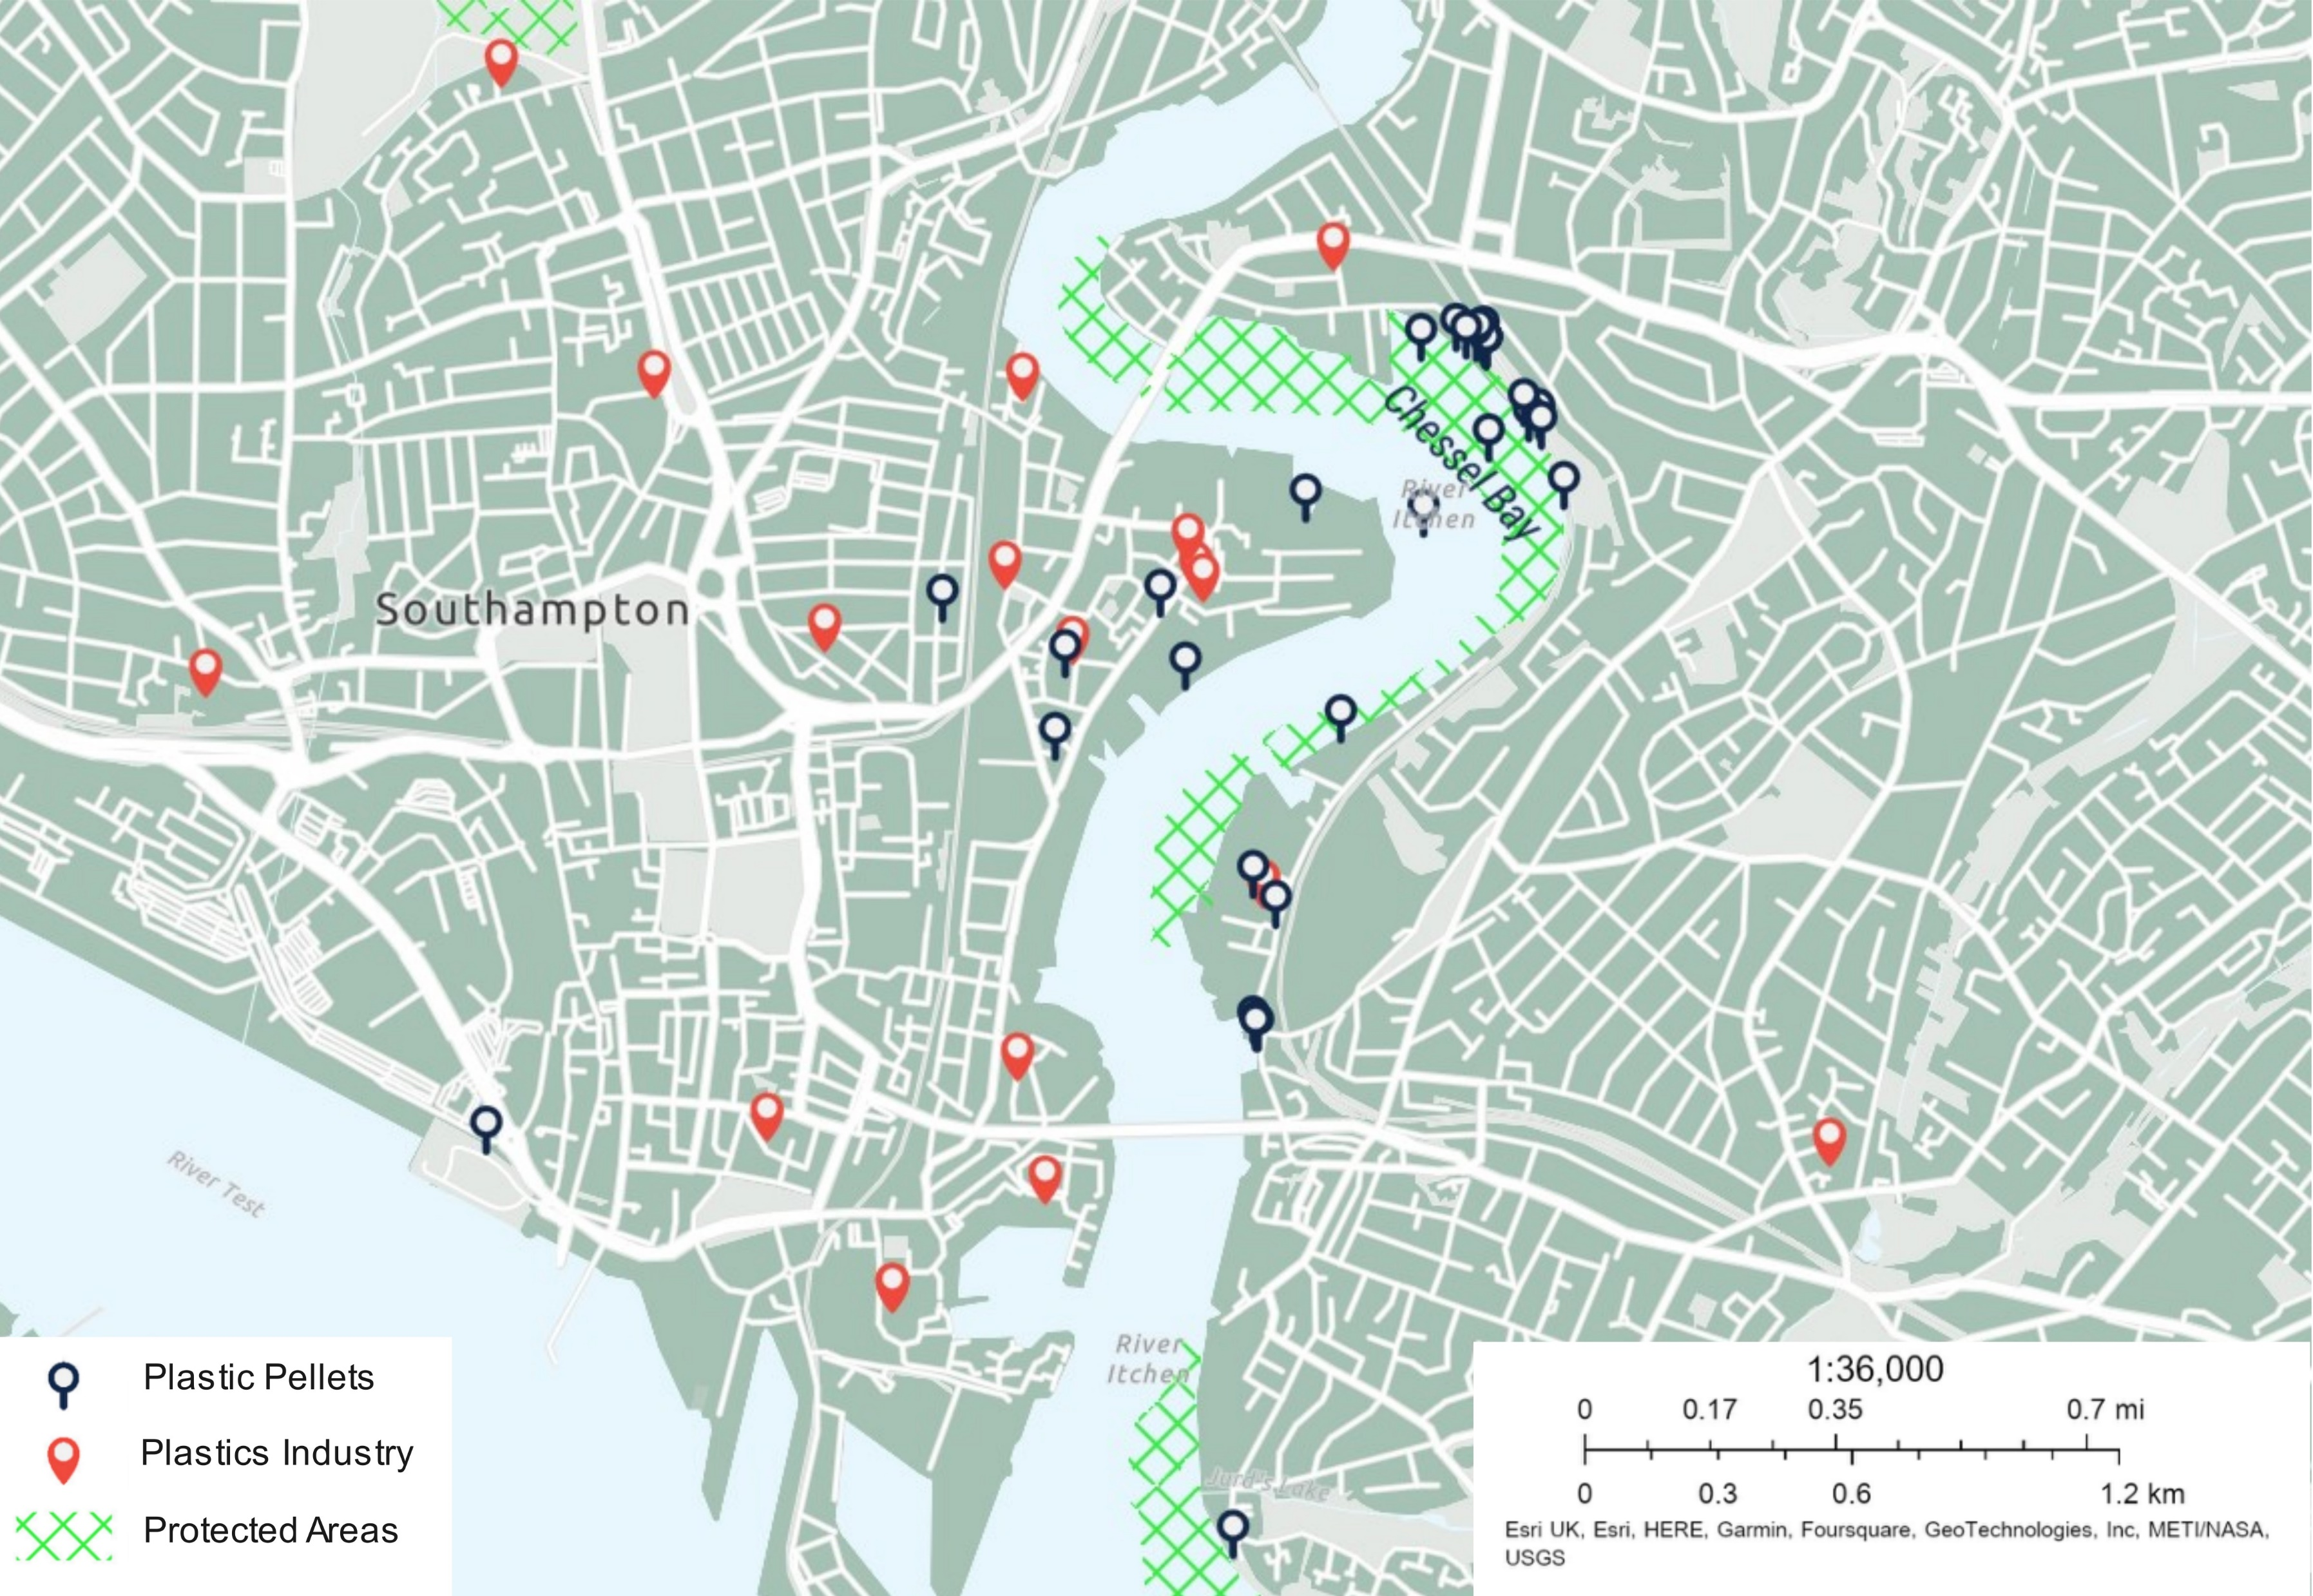
Chronic Pellet Loss Case Study - Chessel Bay, England
Mapping The Global Plastic Pellet Supply Chain
Estuarine salt march and mud flat located in Southampton along River Itchen
Nature Reserve, Site of Special Scientific Interest (SSSI), Special Protection Area (SPA), Ramsar Site
Reported pellets since 2011 in 2023 potentially from mismanagement of pellets from local plastic manufacturers
Approximately 243 million pellets and other microplastic fragments recovered from site to date
Impacting nationally and internationally important habitats and seascapes with unknown environmental, chemical and health risks
Improvements required by following and enforcing PAS510:2021
Map of the mouth of River Itchen and identified pellets, plastic industries and protected areas

Slide 11
Mapping The Global Plastic Pellet Supply Chain
More information and assets can be found at:
https://hub.nurdlehunt.org/resource/oracle-mapping-the-global-plastic-pellet-supply-chain/

