Slide 1
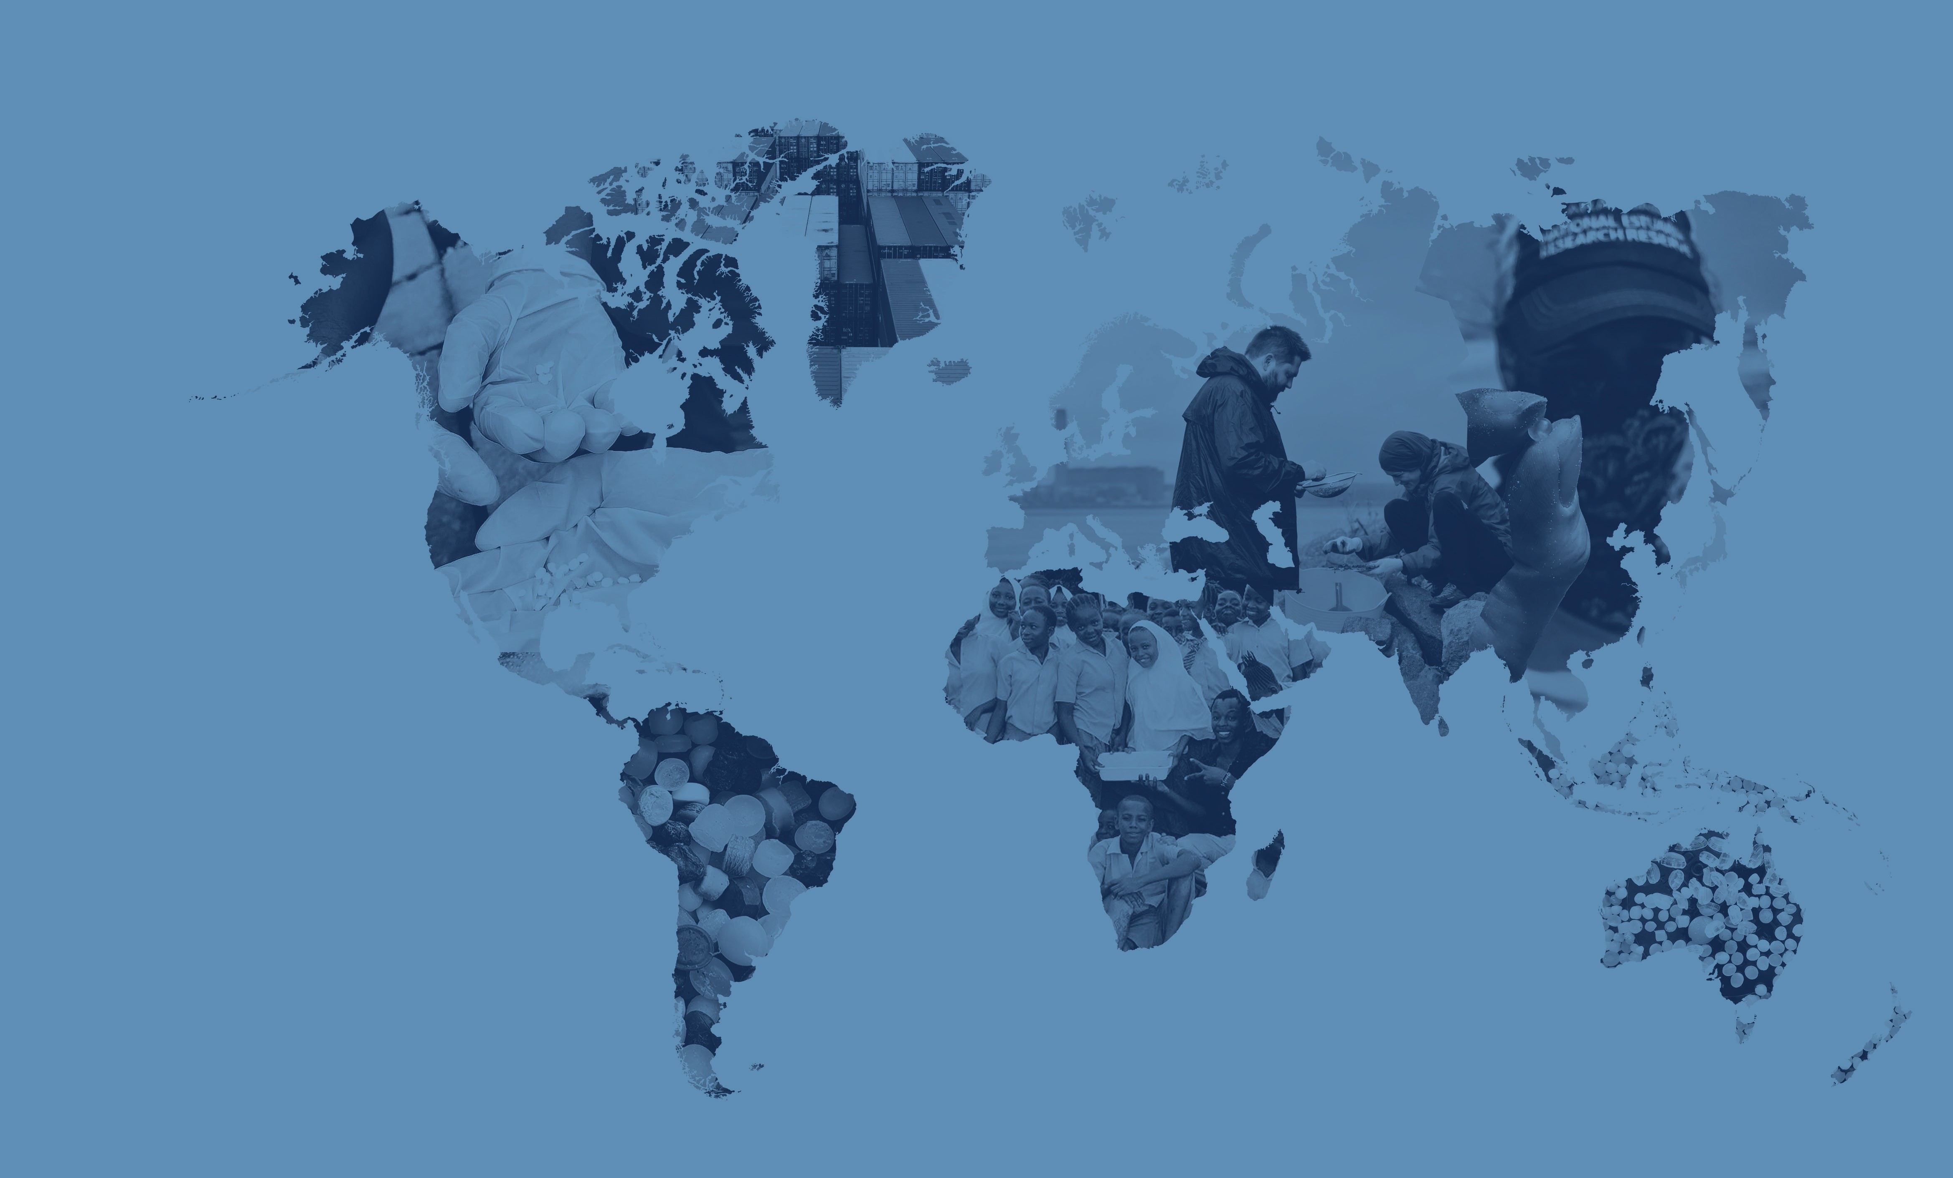
Mapping
The Global Plastic Pellet Supply Chain
Fidra is a Scottish registered charity and SCIO no.SC043895

Slide 2
Global Plastics Outlook
In 2021 world plastic production reached 390 million tonnes and this is predicted to grow to 1,200 million tonnes annually by 2060.
The plastics industry is truly global with 73% of countries importing primary plastics in 2021 and plastic products used by almost every person on the planet.
Most primary plastic is produced in the form of plastic pellets. It is estimated that up to 22.4 trillion pellets are released to the environment each year

Slide 3
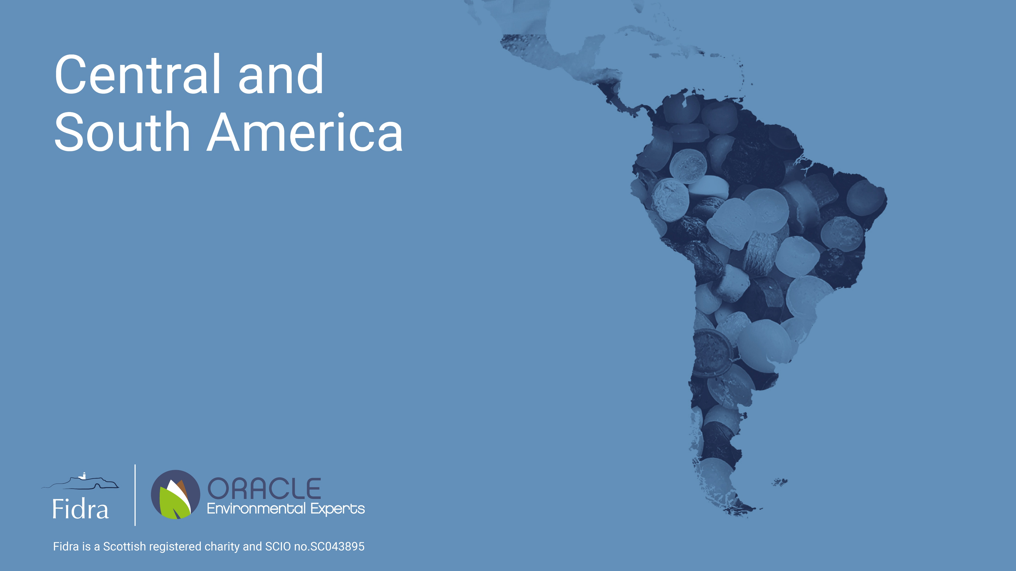
Fidra is a Scottish registered charity and SCIO no.SC043895

Slide 4
Central & South America
The region accounted for 4% of global plastic production in 2021
Primary plastics exported by 19 countries and imported by 26 countries
Region with the smallest predicted annual pellet loss based on industry activity

Slide 5
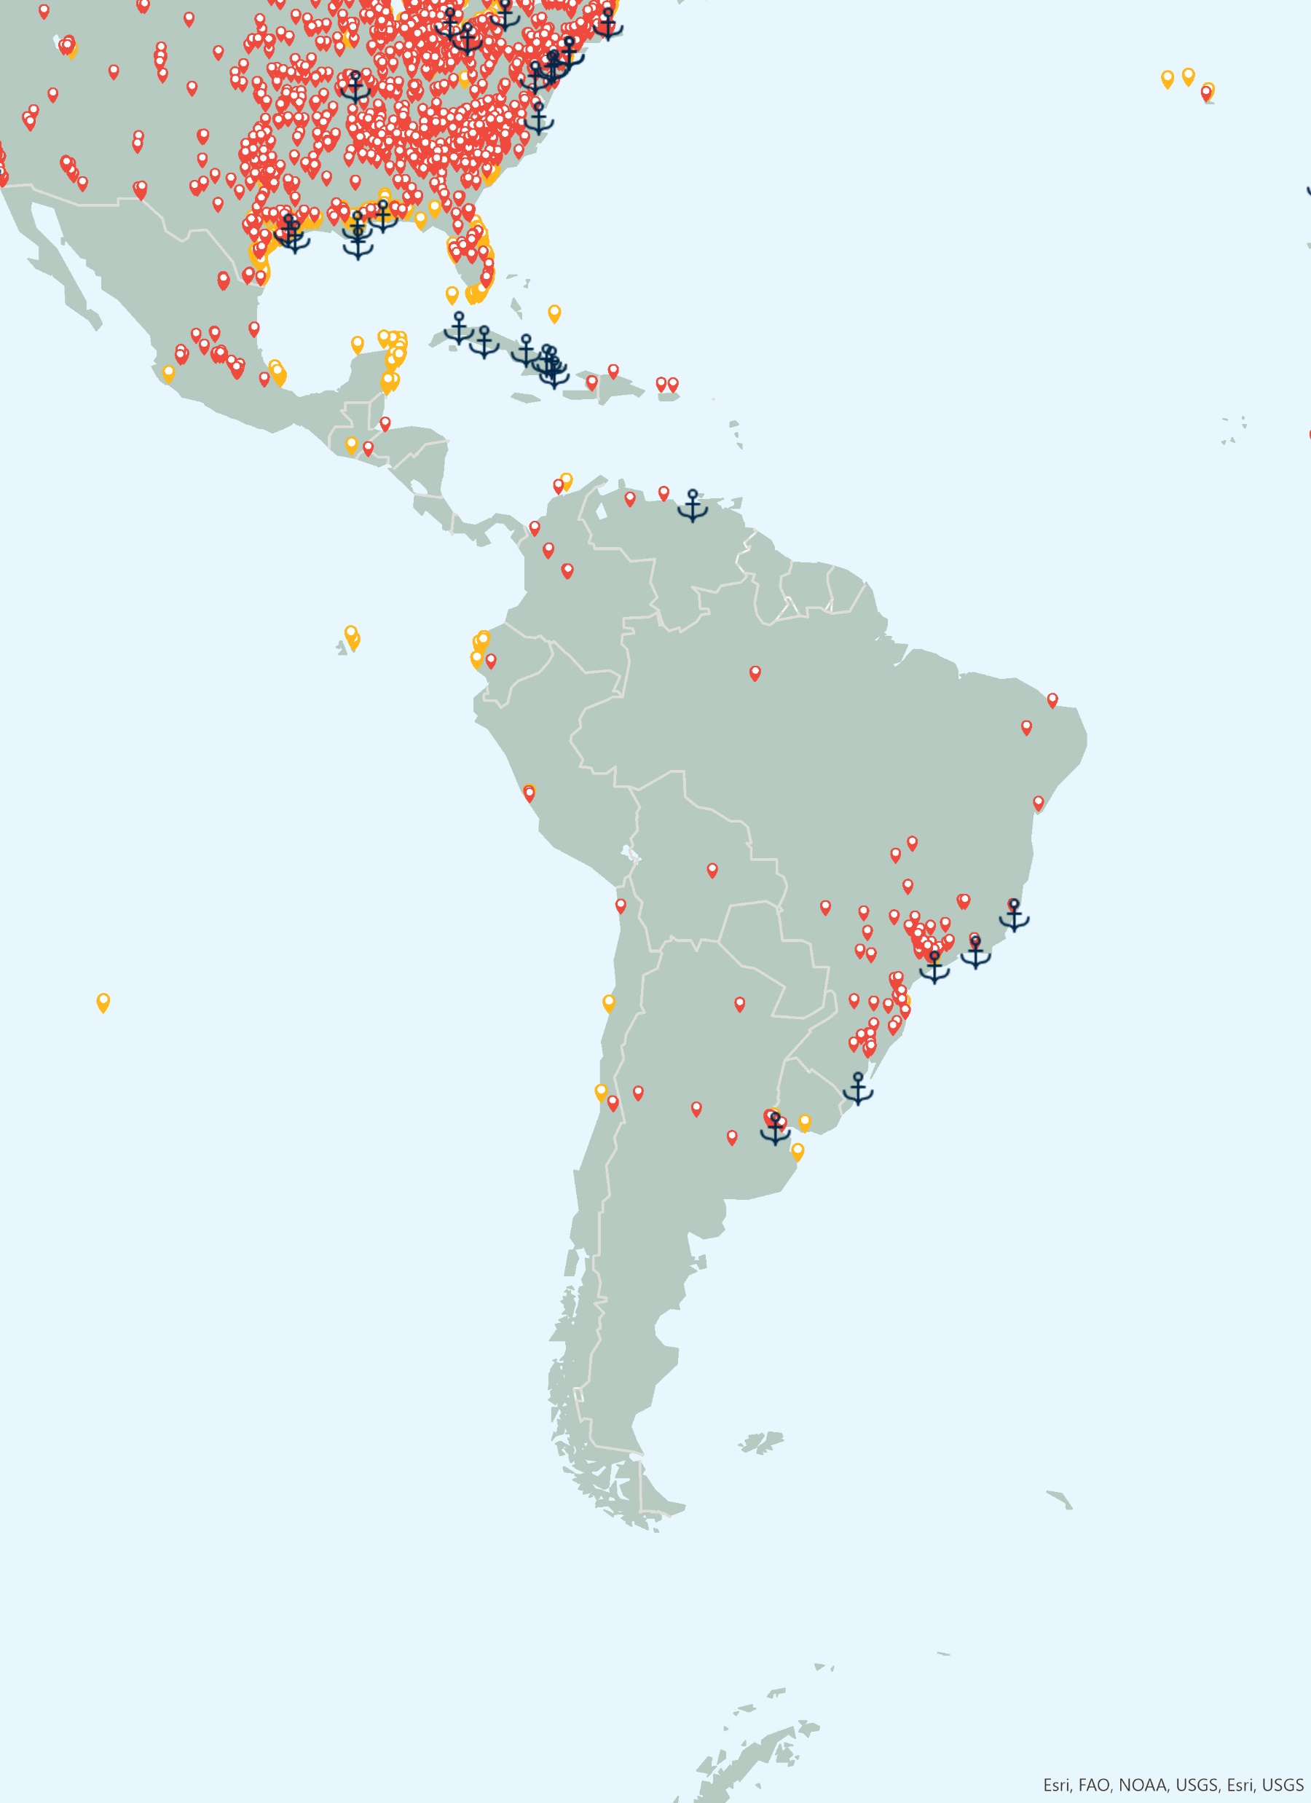
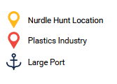
Key Findings
Mapping The Global Plastic Pellet Supply Chain
P3
Central & South America accounted for 4% of global plastic production in 2021¹
Brazil was the largest importer and exporter of primary plastics, by trade value, in 2021²
Accounted for 1.72% of world trade exports of plastics in primary forms in 2021 ²
Accounted for 5.49% of world trade imports of plastics in primary forms in 2021 ²
Over 198 plastics recycling plants ³ (7% of global share based on industry database)
57% of identified recycling plants in the region are in Brazil ³
Plastics industry, nurdle hunts and large ports
Citations:
1 Plastics Europe - https://plasticseurope.org/knowledge-hub/plastics-the-facts-2022, 2022.
2. World Bank. World Integrated Trade Solutions. https://wits.worldbank.org
3. ENF Recycling - World's Largest Directory Of Recycling Companies. [https://www.enfrecycling.com/

Slide 6
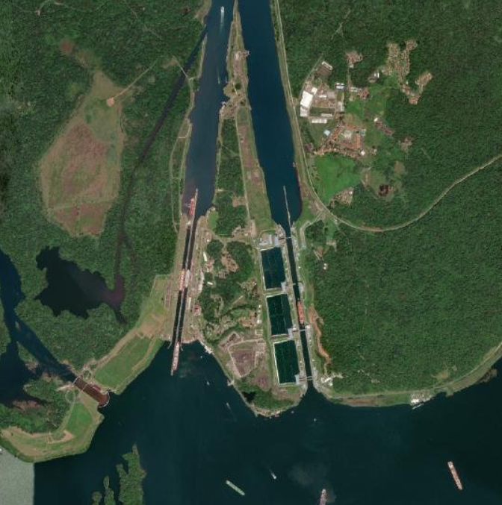
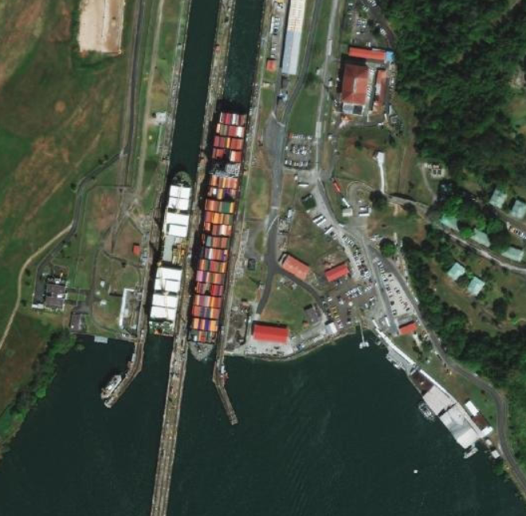
Transport
Mapping The Global Plastic Pellet Supply Chain
P3
The region has 2 of the world’s top 50 container ports by volume handled and 12 large ports¹ handling over 58 million TEU of container traffic in 2021²
Brazil
Transport by road accounted for 65% and rail 15% of freight movements in 2015³
Panama Canal – The majority (73.7%) of cargo passing through the canal originated from The United States in 2022. The United States was the largest exporter of primary plastics in 2021 ⁴
The Port of Colon, at the northern end of the Panama Canal, is the busiest container report in the region by cargo volume handling 4.92 million TEU in 2021²
TEU- twenty-foot equivalent unit
Gatun High Locks, Panama Canal (Esri, Maxar)
Citations:
1. World Ports Index (https://msi.nga.mil/Publications/WPI)
2. World Bank, World Development Indicators, https://databank.worldbank.org/source/world-development-indicators
3. Panama Canal Authority. https://pancanal.com/wp-content/uploads/2022/10/Table10.pdf
4. World Bank. World Integrated Trade Solutions. https://wits.worldbank.org

Slide 7
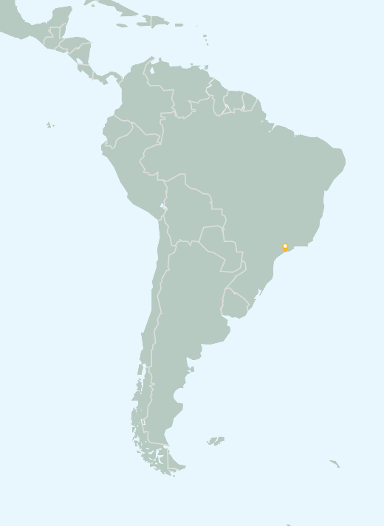
Pellet Loss
Mapping The Global Plastic Pellet Supply Chain
P3
Estimated that 1,600-16,000 tonnes of pellets lost to the environment annually
1 chronic loss identified to date in this region
Acute & Chronic pellet loss incidents
Citations:
1. Fidra. The Great Nurdle Hunt, https://www.nurdlehunt.org.uk,
2. Nurdle Patrol, https://nurdlepatrol.org.map

Slide 8
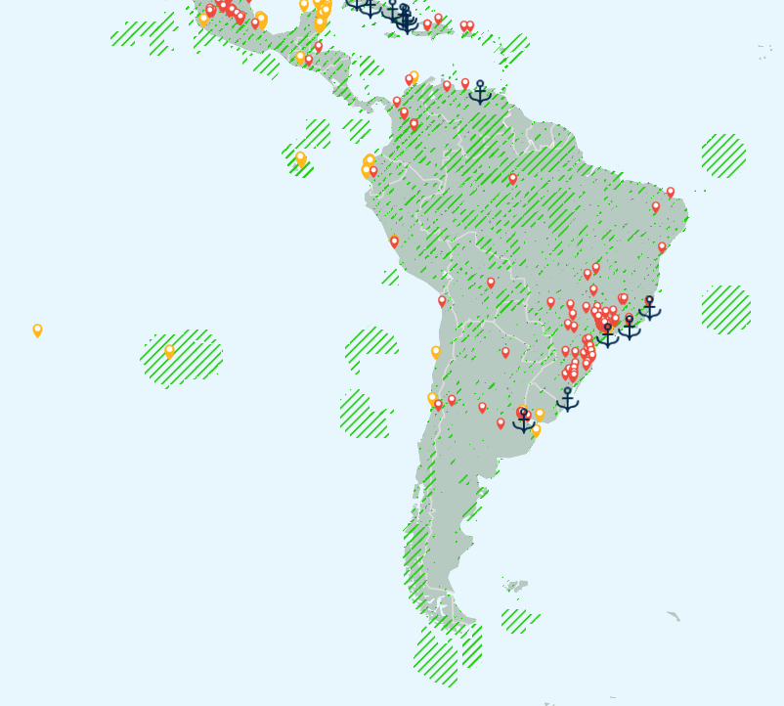
Fishing & Protected Areas
Mapping The Global Plastic Pellet Supply Chain
P3
Over 4.9 million km² of terrestrial protected areas- 24.29 % of land area¹
Over 5.5 million km² of marine protected areas¹
Fishing²
Country | Fish landed in domestic ports (tonnes) (2020 or latest available data)
Argentina | 789,000
Brazil | 484,000
Chile | 2,600,000
Colombia | 71,000
Costa Rica | 25,000
Peru | 5,600,000
Citations:
1. Protected Planet, https://www.protectedplanet.net/en
2. OECD Fish landings, https://data.oecd.org/fish/fish-landings.htm#indicator-chart)

Slide 9
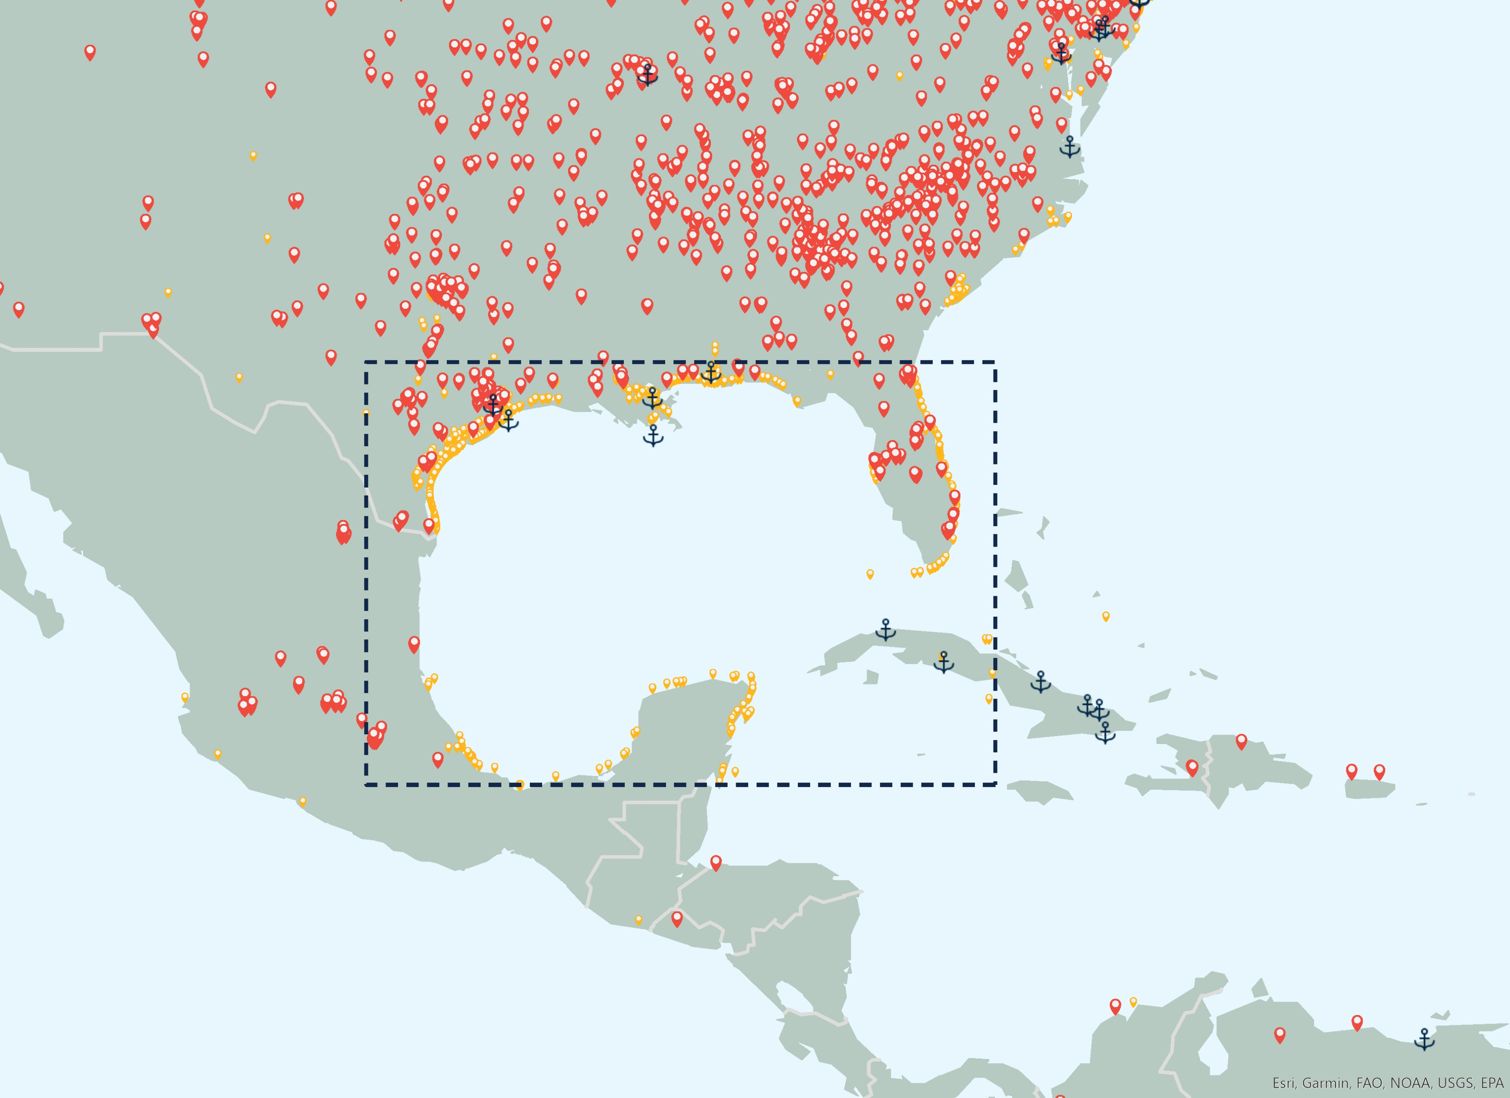
Tourism & Protected Areas
Mapping The Global Plastic Pellet Supply Chain
P3
The Gatun Lake, Panama, contains over 63 km² of marine protected area¹. Shipping traffic transits through the Gatun Lake between the north and south locks of the Panama Canal.
Key shipping routes from the Gulf of Mexico, a hub for plastics manufacture, to China pass through the Panama Canal.
Poses risk to other nations with reliance on tourism and fishing in Caribbean Sea.
Tourism ² Antigua and Barbuda - 14.6% of GDP
Jamaica - 9.2% of GDP
Gulf of Mexico
Citations:
1. Protected Planet, https://www.protectedplanet.net/en
2. UN WTO – Global and regional tourism performance (https://www.unwto.org/tourism-data/global-and-regional-tourism-performance)

Slide 10
Mapping The Global Plastic Pellet Supply Chain
P3
More information and assets can be found at:
https://hub.nurdlehunt.org/resource/oracle-mapping-the-global-plastic-pellet-supply-chain/

