Slide 1
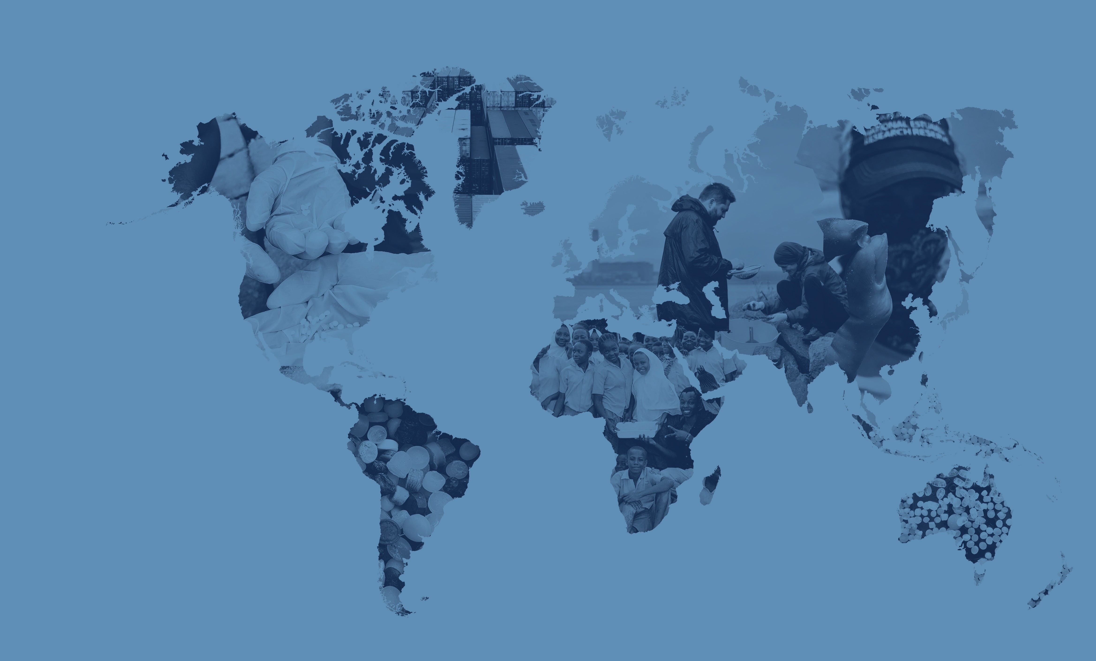
Mapping
The Global Plastic Pellet Supply Chain
Fidra is a Scottish registered charity and SCIO no.SC043895

Slide 2
Global Plastics Outlook
In 2021 world plastic production reached 390 million tonnes and this is predicted to grow to 1,200 million tonnes annually by 2060.
The plastics industry is truly global with 73% of countries importing primary plastics in 2021.
Most primary plastic is produced in the form of plastic pellets. It is estimated that up to 22.4 trillion pellets are released to the environment each year globally.

Slide 3
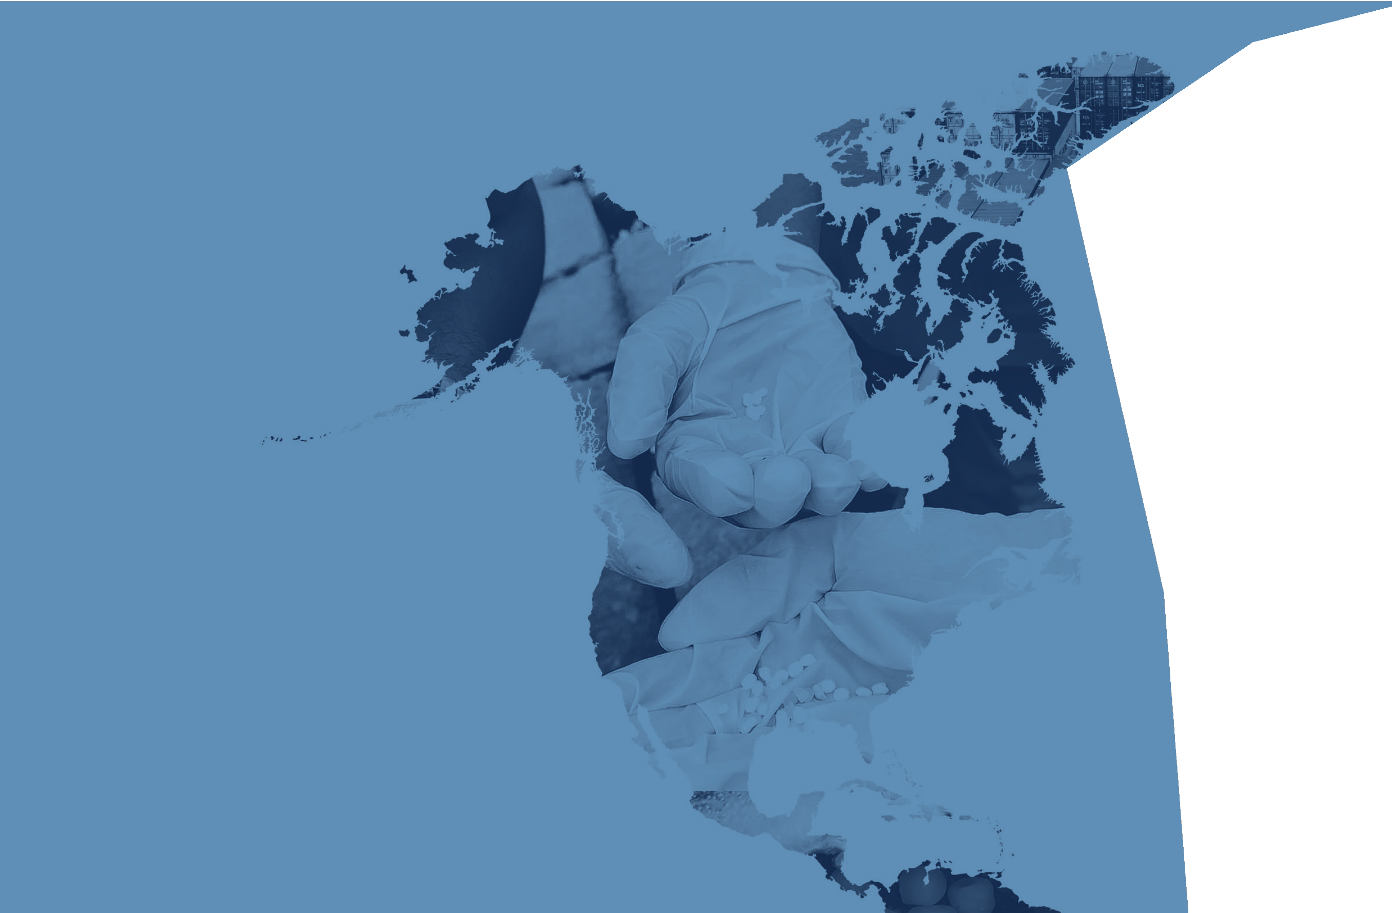
North America & Mexico
Fidra is a Scottish registered charity and SCIO no.SC043895

Slide 4
North America & Mexico
The United States was the world’s largest exporter of primary plastics by trade value in 2021 – over 23.5 billion USD
Nurdles have been found in almost 8,000 locations in North America through citizen science programmes
Highest density of positive nurdle hunts are within the Gulf of Mexico

Slide 5
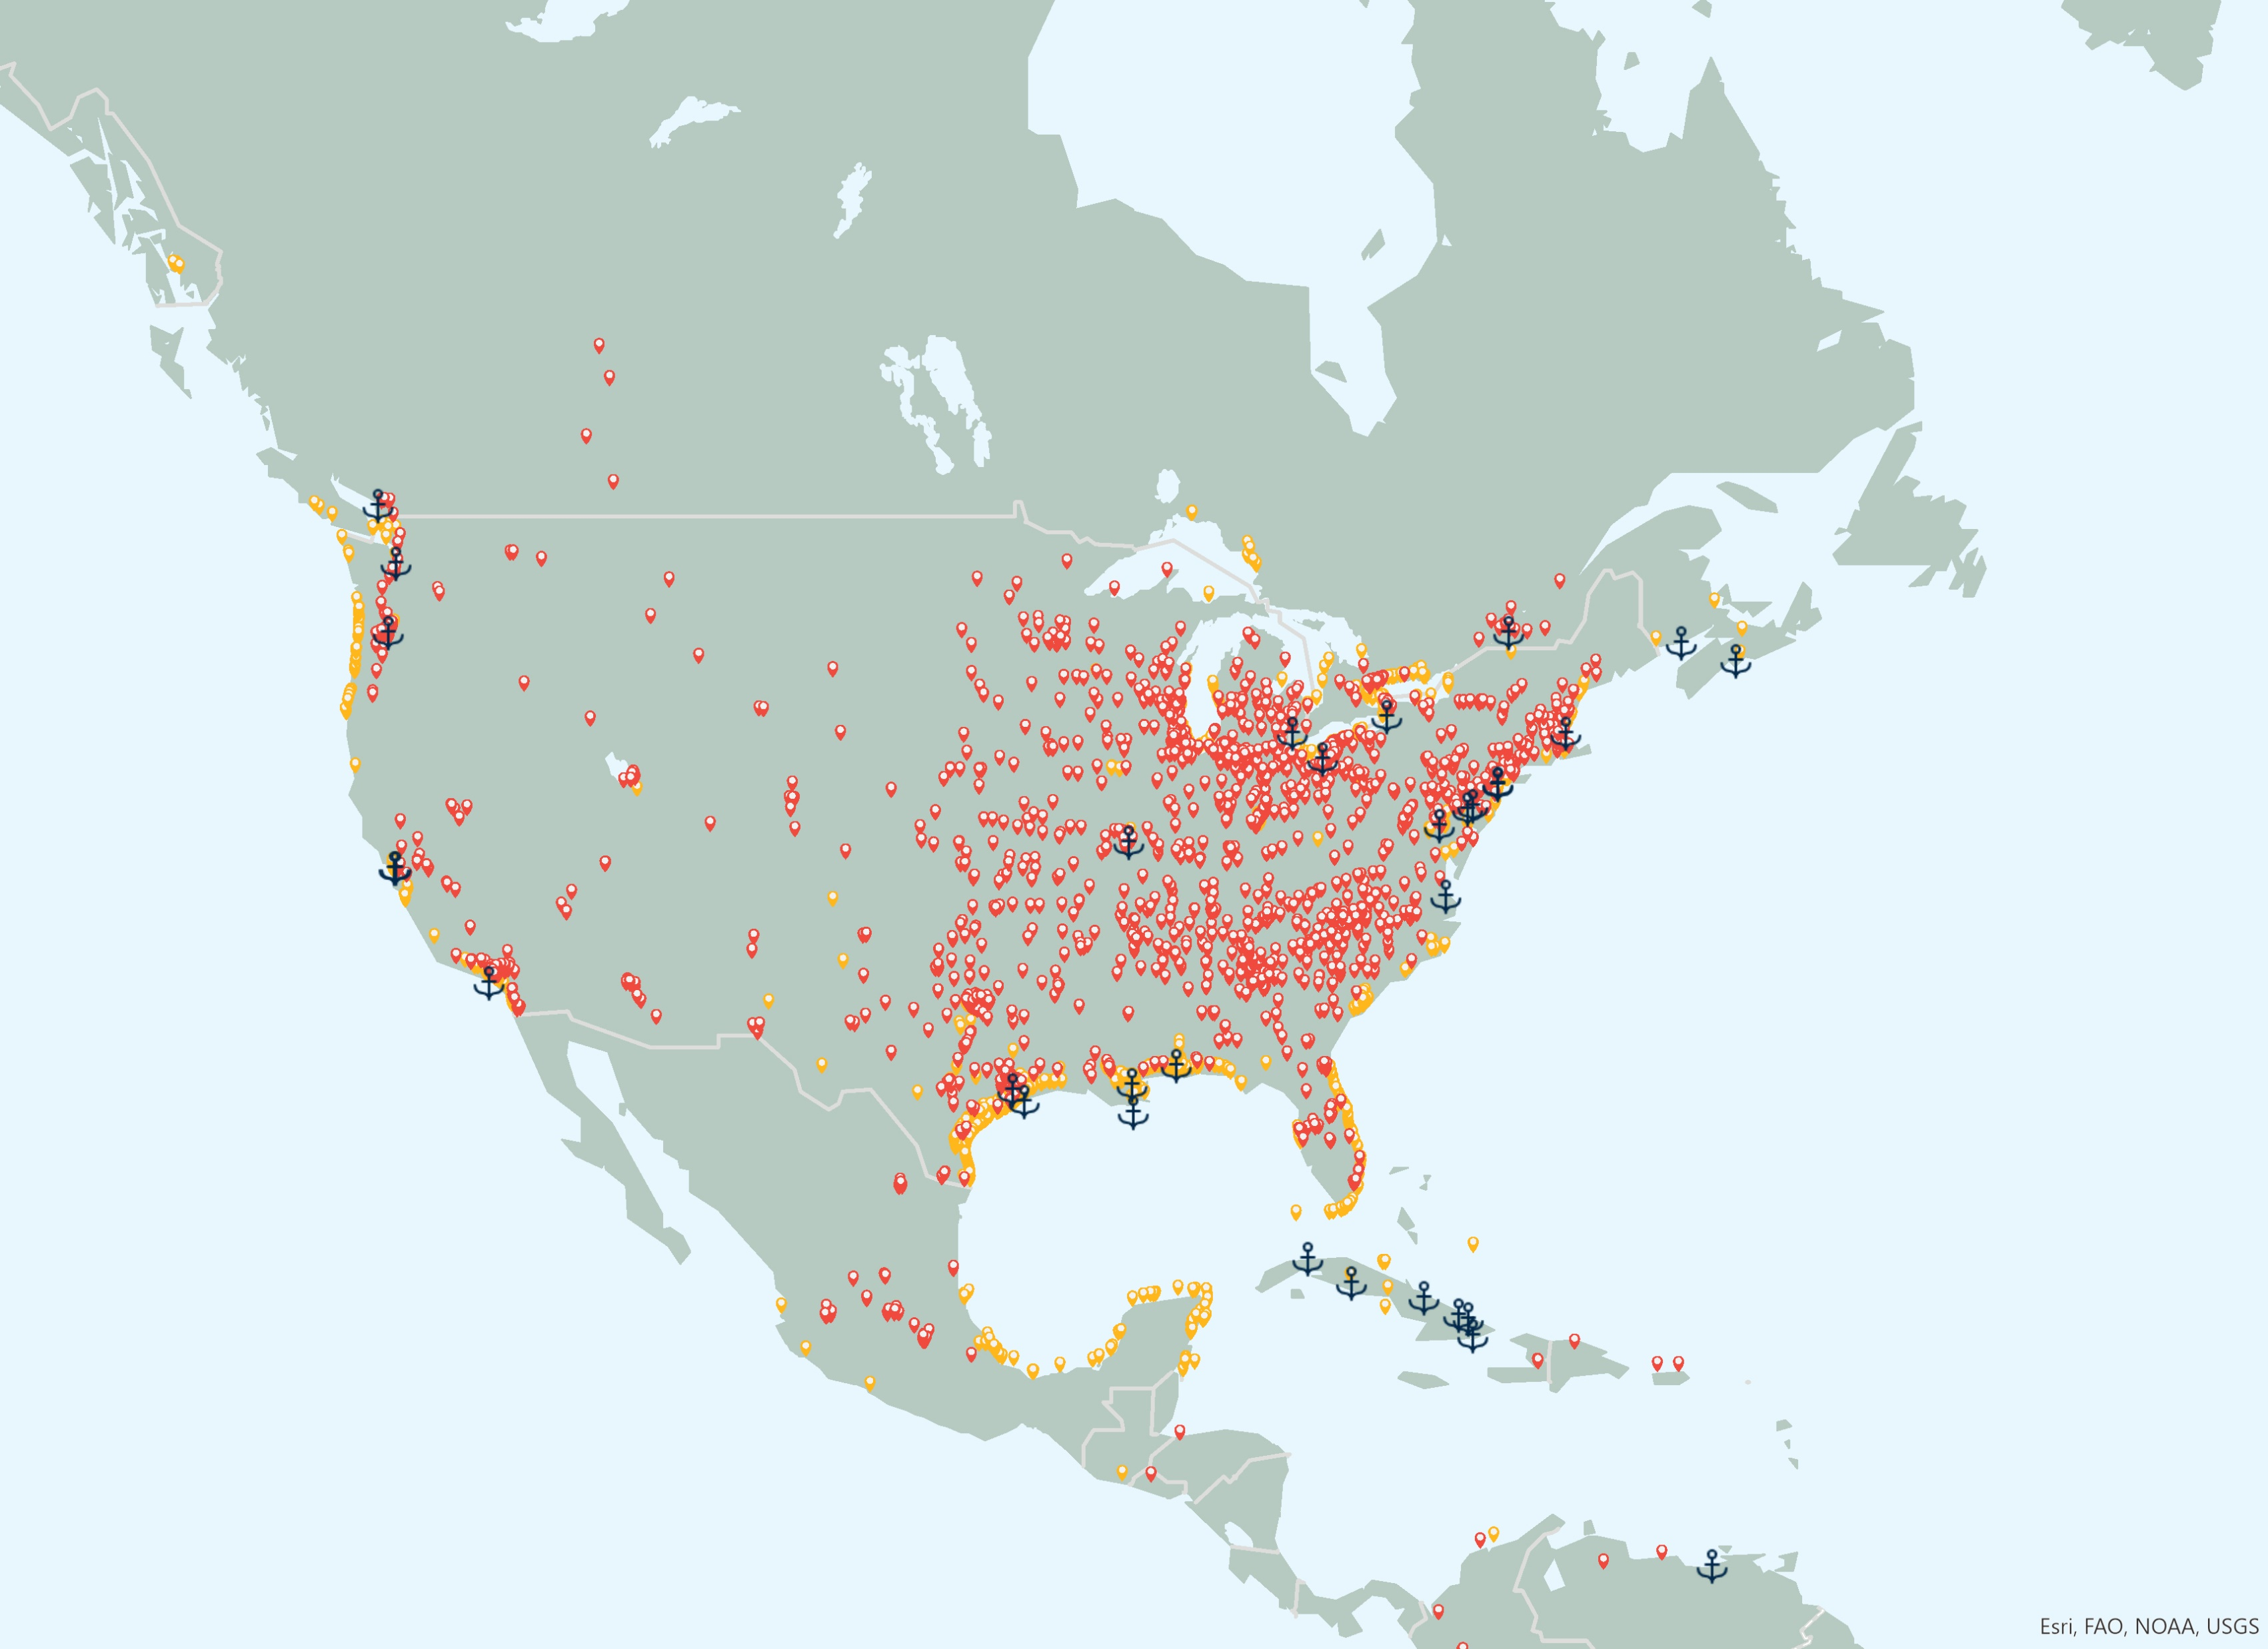
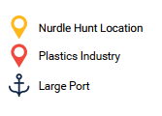
Key Findings
Mapping The Global Plastic Pellet Supply Chain
P3
North America accounted for 18% of global plastic production in 2021¹
The United States was the world’s largest exporter of primary plastics, by trade value, in 2021²
17% of global trade value in primary plastic exports in 2021²
11% of global trade value in primary plastic imports in 2021²
Almost 1 million people employed in the plastics industry in the United States³
Over 290 plastic recycling plants identified in North America with 195 in the US⁴
Plastics industry, nurdle hunts and large ports in North America
Citations:
1 Plastics Europe - https://plasticseurope.org/knowledge-hub/plastics-the-facts-2022, 2022.
2. World Bank. World Integrated Trade Solutions. https://wits.worldbank.org
3. 2022 Size and Impact Report, Plastics Industry Association (https://www.plasticsindustry.org/sizeandimpact)
4. ENF Recycling - World's Largest Directory Of Recycling Companies. [https://www.enfrecycling.com/

Slide 6
Key Findings
Mapping The Global Plastic Pellet Supply Chain
P3
Canada was 11th largest importer and exporter of primary plastics in 2021¹
Mexico was 7th largest importer and 33rd largest exporter of primary plastics in 2021¹
54 plastic recycling plants identified in Canada and 42 in Mexico²
Over 2,555 plastics facilities in Canada³
Plastics industry, nurdle hunts and large ports in North America
Citations:
1. World Bank. World Integrated Trade Solutions. https://wits.worldbank.org
2.. ENF Recycling - World's Largest Directory Of Recycling Companies. [https://www.enfrecycling.com/
3. Government of Canada, Summary – Canadian Industry Statistics, 3261- Plastic Product Manufacturing (https://ised-isde.canada.ca/app/ixb/cis/summary-sommaire/3261)

Slide 7
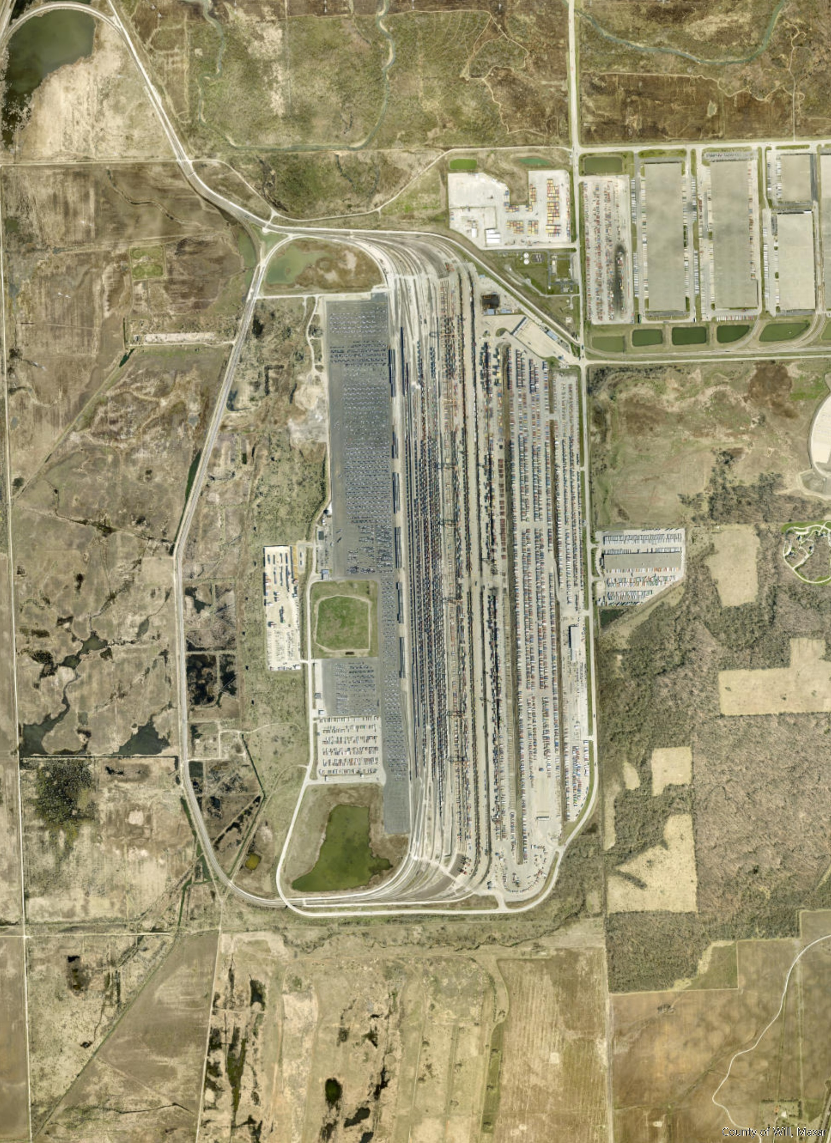
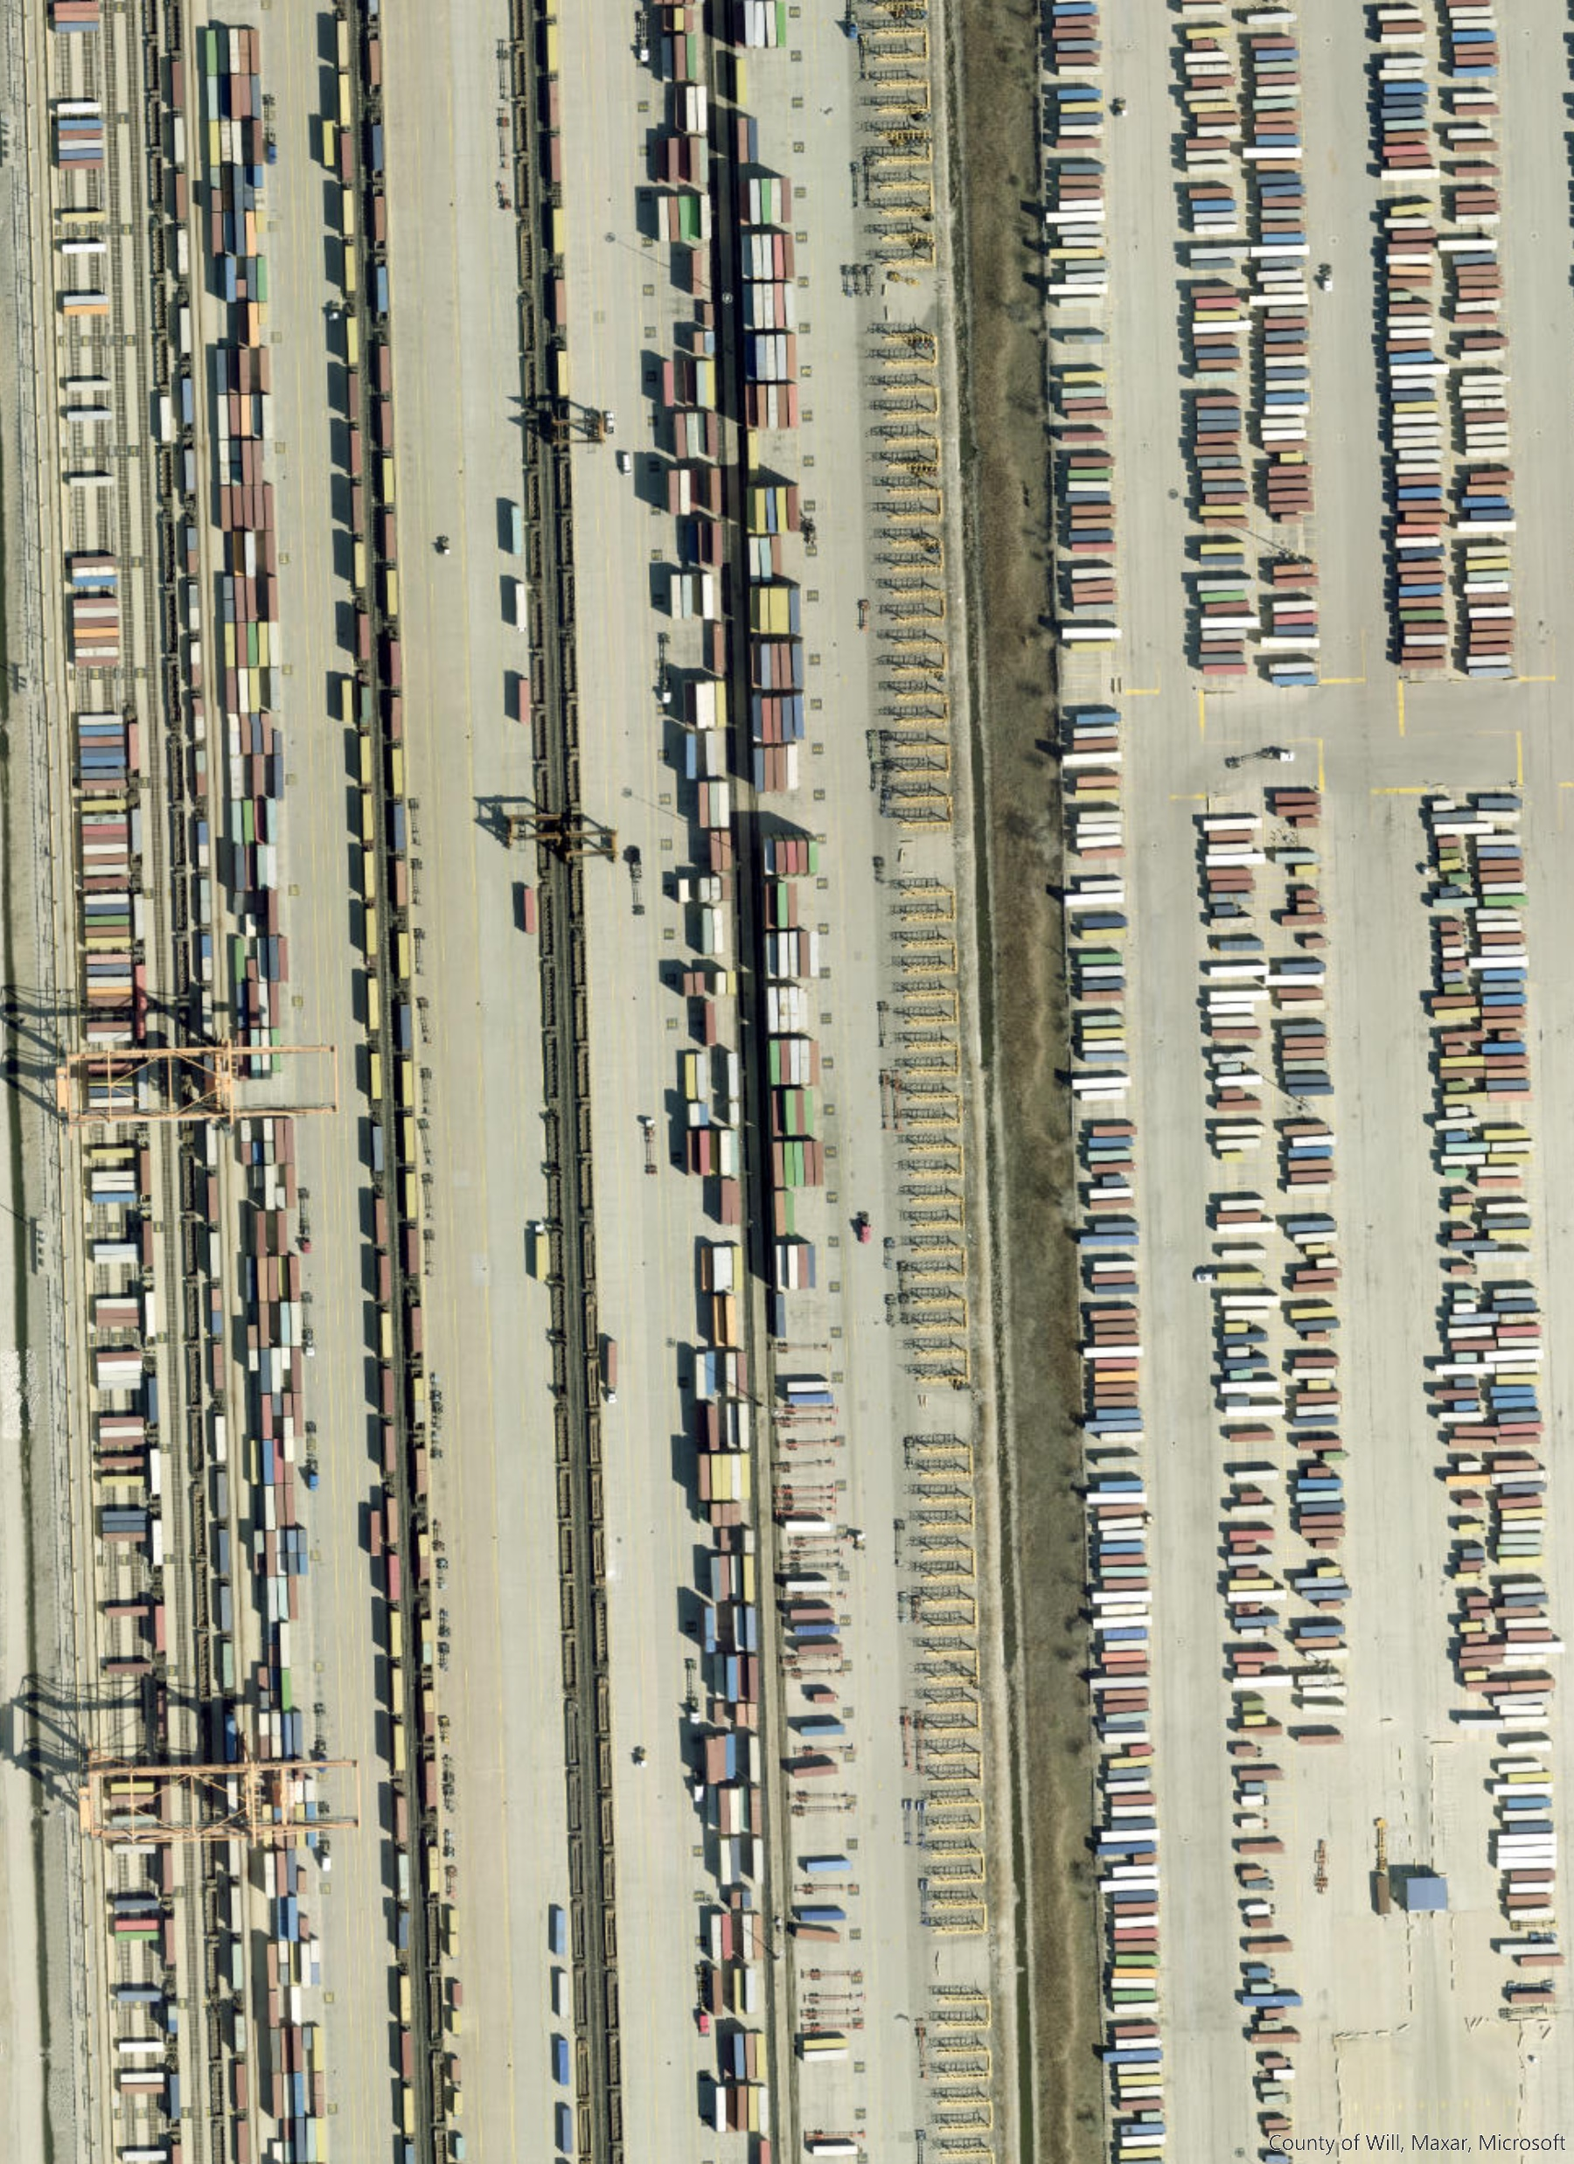
Transport
Mapping The Global Plastic Pellet Supply Chain
P3
North America has 4 of the world’s top 50 container ports by volume handled and 30 large ports¹ handling over 67 million TEU of container traffic in 2021⁶
USA
Almost 140,000 miles of freight railway line²
Large intermodal transport network
1,182 train derailments in 2022 ³ –around 3 per day - 5 pellet loss incidents involving train derailments have been identified
65% of freight transported by truck and 8% by rail in 2017⁴ - 2 pellet loss incidents involving road transport
Canada
20,000 miles of freight railway and 14 intermodal terminals⁵
TEU- twenty-foot equivalent unit
Intermodal depot, USA, 2.8km long and 2.6km² (Esri, Earthstar Geographics)
Citations:
1. World Ports Index (https://msi.nga.mil/Publications/WPI)
2. Association of American Railroads, Rail Freight Facts & Figure (May 2023), (https://www.aar.org/wp-content/uploads/2023/04/AAR-Facts-Figures-Fact-Sheet.pdf)
3. Federal Railroad Administration, Office of safety analysis (https://safetydata.fra.dot.gov/officeofsafety/publicsite/summary.aspx)
4. US Bureau of Transportation Statistics - https://data.bts.gov/stories/s/Moving-Goods-in-the-United-States/bcyt-rqmu
5. CN, Maps and Network, https://www.cn.ca/en/our-services/maps-and-network/intermodal-terminals/
6. World Bank, World Development Indicators, https://databank.worldbank.org/source/world-development-indicators

Slide 8
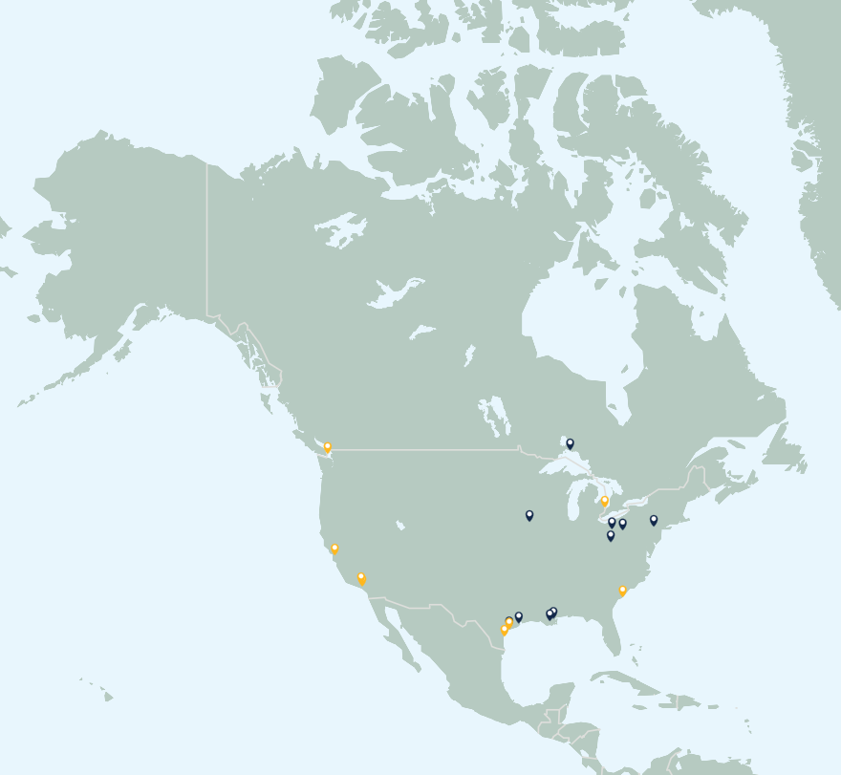
Pellet Loss
Mapping The Global Plastic Pellet Supply Chain
P3
Estimated that 6,000-60,000 tonnes of pellets lost to the environment annually
10 acute and 8 chronic pellet losses identified
3 losses account for more than 1.6 billion pellets lost
12 losses related to transport network
6 losses related to industry
7,963 positive nurdle hunts identified in North America ^{1,2}
Acute & Chronic pellet loss incidents (2005-2022)
Citations:
1. Fidra. The Great Nurdle Hunt, https://www.nurdlehunt.org.uk,
2. Nurdle Patrol, https://nurdlepatrol.org.map

Slide 9
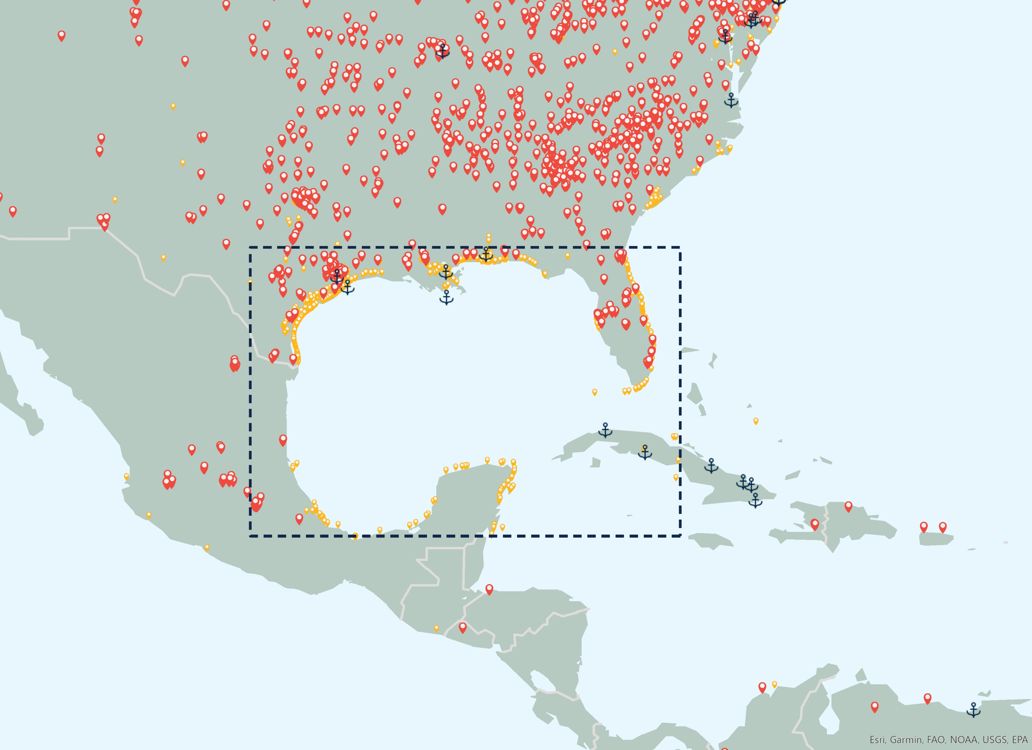
Tourism & Protected Areas
Mapping The Global Plastic Pellet Supply Chain
P3
Gulf of Mexico
135 plastic facilities identified
112,000 km² of protected areas¹
6,117 positive nurdle hunts
1,378 positive nurdle hunts within protected areas (22.5%)
Poses risk to other nations with reliance on tourism and fishing in Caribbean Sea
Florida is second most visited US state
Tourism² Antigua and Barbuda - 14.6% of GDP
Jamaica - 9.2% of GDP
Gulf of Mexico
Citations:
1. Protected Planet, https://www.protectedplanet.net/en
2. UN WTO – Global and regional tourism performance (https://www.unwto.org/tourism-data/global-and-regional-tourism-performance)

Slide 10
Mapping The Global Plastic Pellet Supply Chain
P3
More information and assets can be found at:
https://hub.nurdlehunt.org/resource/oracle-mapping-the-global-plastic-pellet-supply-chain/

